Slide 1
Tensions in Teaching Mathematics - Insights into Professional Growth
Annette Rouleau
Simon Fraser University

Slide 2
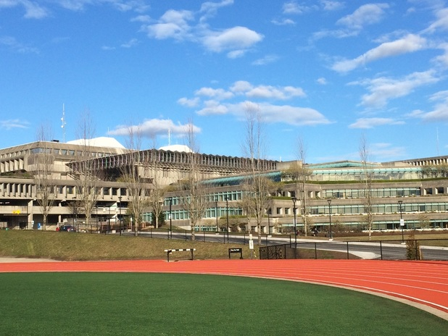

Slide 3
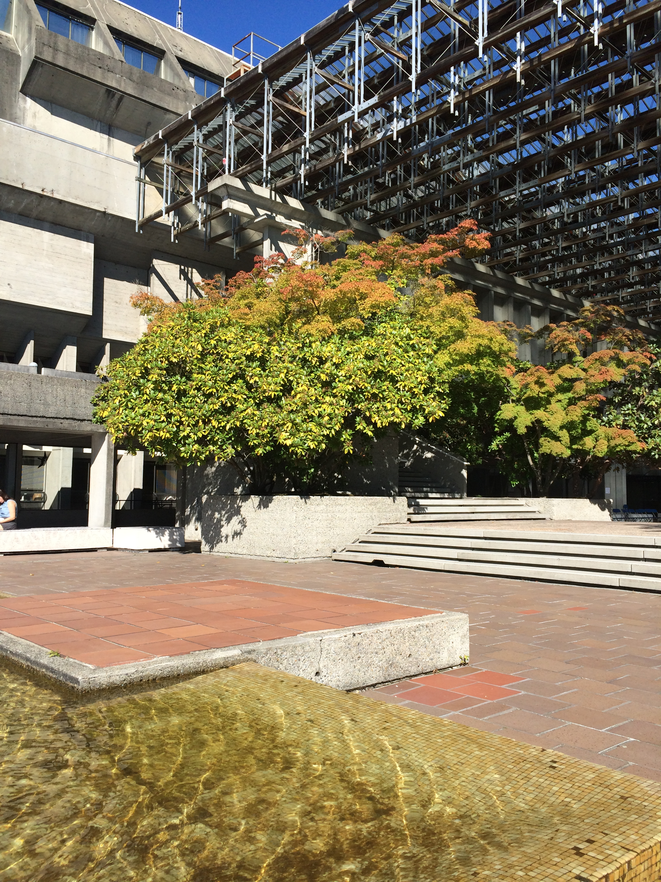

Slide 4
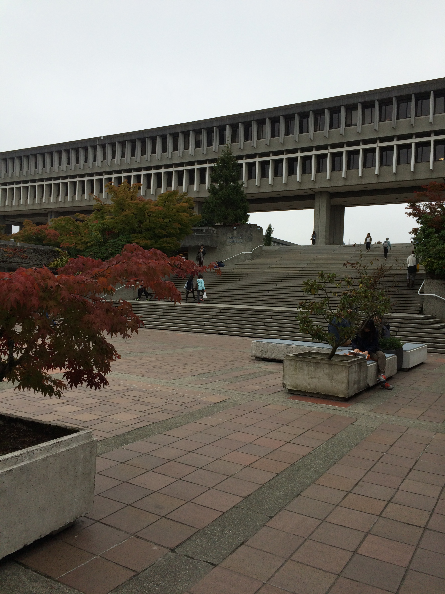

Slide 5
Dr. Nathalie Sinclair
Dr. David Pimm
Dr. Rina Zazkis

Slide 6
Tension

Slide 7
~striving to attain competing, worthwhile aims~
(Ball, 1993)
Tension is described variously in research as:
~deliberating about alternatives rather than making choices~
(Nicol, 1997)
~a situation in which a perfect solution is not available~
(Katz & Rath, 1992)

Slide 8
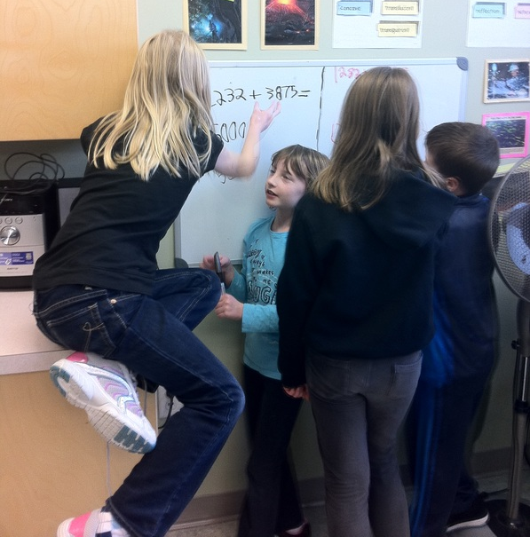
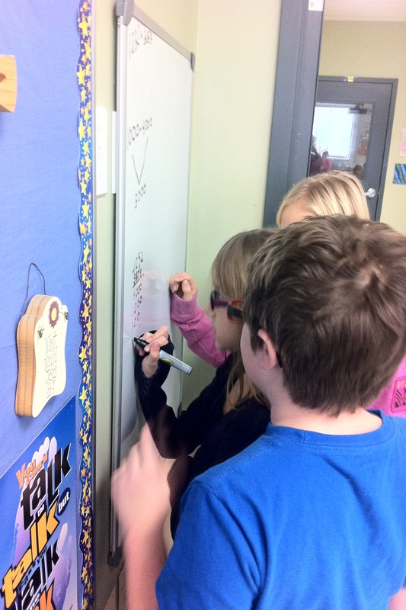
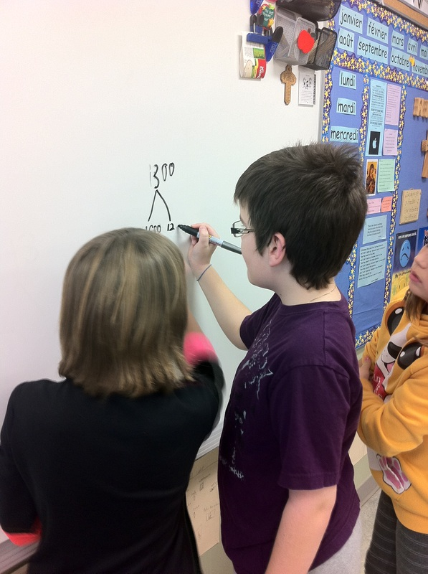
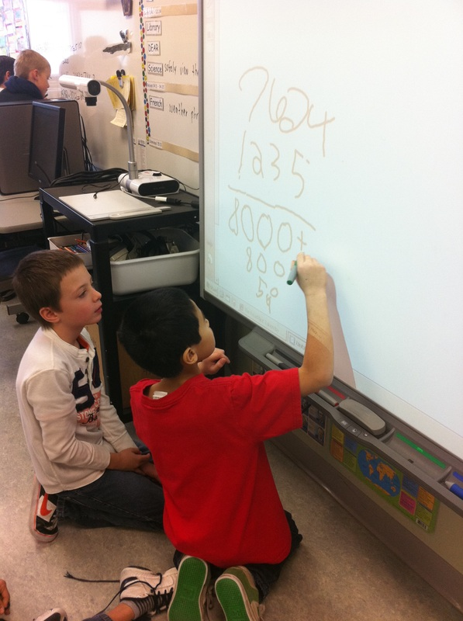

Slide 9
Tensions:
are endemic to the teaching profession
encompass the inner turmoil teachers experience when faced with contradictory alternatives for which there are no clear answers
are not problems to be solved - they result in good-enough compromises, not neat solutions

Slide 10
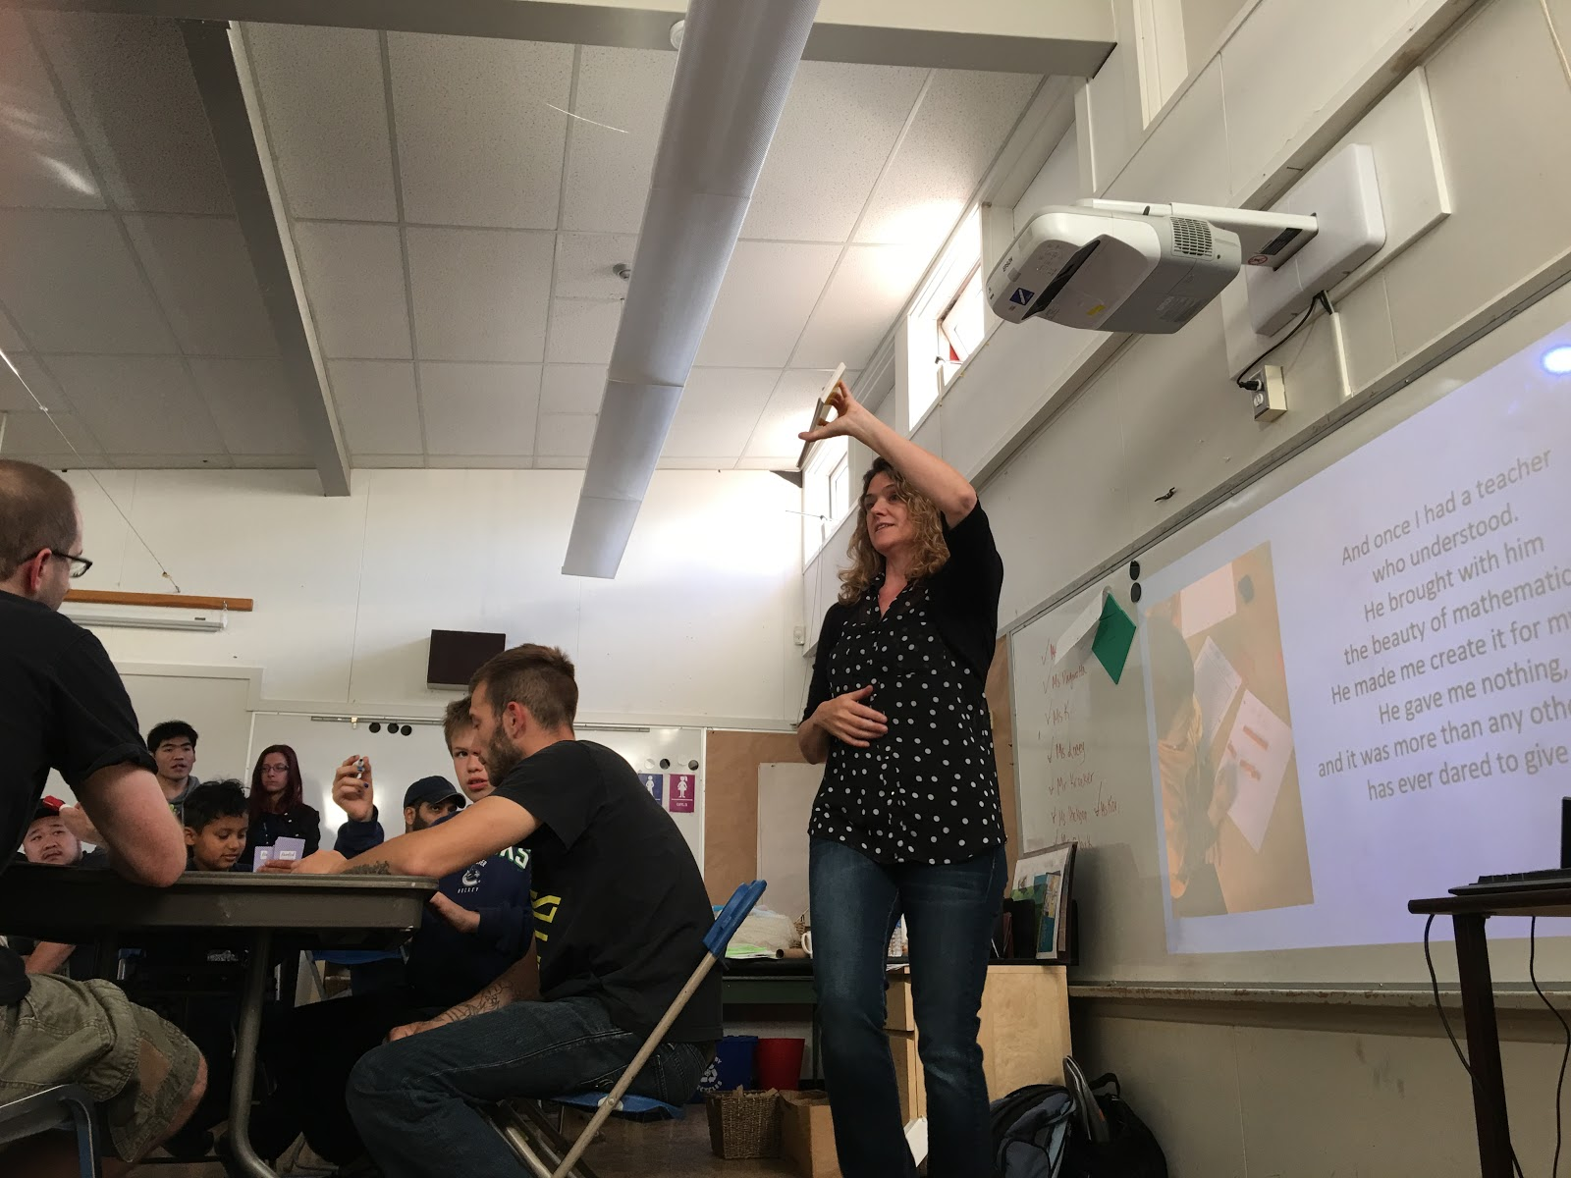

Slide 11
Tensions?
What tensions do mathematics teachers experience?
How do teachers cope with tensions?
What effect does this have on their mathematics teaching practice and professional growth?

Slide 12
Berlak and Berlak (1981)
identified sixteen dilemmas for the purpose of illuminating the relationship between everyday school events to broader social, economics, and political issues
Berlak and Berlak (1981)
identified sixteen dilemmas for the purpose of illuminating the relationship between everyday school events to broader social, economics, and political issues
Lampert (1985)
teachers are dilemma managers who accept conflict as endemic and even useful to practice rather than as a burden that needs to be eliminated
Lampert (1985)
teachers are dilemma managers who accept conflict as endemic and even useful to practice rather than as a burden that needs to be eliminated
Adler (1998)
the language of tensions is “a powerful explanatory and analytic tool, and a source of praxis for mathematics teachers.” (p. 26)

Slide 13
Berry (2007)
utilized the notion of tension as a framework for both undertaking and analyzing her research
The result was twelve tensions expressed as dichotomous pairs that “capture the sense of conflicting purpose and ambiguity held within each” (Berry, 2007, p. 120)
Noting that these tensions do not exist in isolation, she used their interconnectedness as a lens to examine her practice

Slide 14
Berry’s Tension Framework:
Telling and growth
between informing and creating opportunities to reflect and self-direct
between acknowledging prospective teachers’ needs and concerns
and challenging them to grow.

Slide 15
Berry’s Tension Framework:
Telling and growth
Confidence and uncertainty
between making explicit the complexities and messiness of teaching
and helping prospective teachers feel confident to progress
between exposing vulnerability as a teacher educator and maintaining
prospective teachers’ confidence in the teacher educator as a leader.

Slide 16
Berry’s Tension Framework:
Telling and growth
Confidence and uncertainty
Safety and challenge
between a constructive learning experience and an uncomfortable
learning experience.

Slide 17
Berry’s Tension Framework:
Telling and growth
Confidence and uncertainty
Safety and challenge
Action and intent
between working towards a particular ideal and jeopardising that ideal
by the approach chosen to attain it.

Slide 18
Berry’s Tension Framework:
Telling and growth
Confidence and uncertainty
Safety and challenge
Action and intent
Valuing and reconstructing experience
between helping students recognise the ‘authority of their experience’
and helping them to see that there is more to teaching than simply
acquiring experience.

Slide 19
Berry’s Tension Framework:
Telling and growth
Confidence and uncertainty
Safety and challenge
Action and intent
Valuing and reconstructing experience
Planning and being responsive
between planning for learning and responding to learning opportunities as
they arise in practice

Slide 20
Research Question:
Can I identify tension pairs within a
teacher’s mathematics practice?

Slide 21
Methodology:
Naomi
participant on my District Learning Team
two classroom observations
two interviews

Slide 22
Framework:
Telling and growth
Telling and growth
Confidence and uncertainty
Confidence and uncertainty
Safety and challenge
Action and intent
Action and intent
Valuing and reconstructing experience
Planning and being responsive

Slide 23
Analysis:
Telling and Growth
values hands-on, collaborative activities where students talk and work through things together to come up with many different ways to do things
tension arises when she is faced with students who are not accustomed to being taught this way and finds herself reverting back to “old school” teaching
neither managed nor resolved, this tension
became an impetus for change

Slide 24
Analysis:
Confidence and Uncertainty
initially she hid her struggles with math from her students
eventually she felt compelled to reveal her uncertainty deciding “maybe it would be okay if they knew”
her tension is not resolved but it is managed

Slide 25
Analysis:
Action and Intent
aware that her teaching style requires the use of formative assessment
yet her reliance on summative assessment creates tension
another tension in which seeking professional growth is seen as part of the outcome in resolution

Slide 26
Noticings:
limitation in applying Berry’s (2007) framework
tensions emerged that do not fit within the prescribed categories
beneficial to consider further categorizing the tensions according to whether they are personal or pedagogical tensions, or possibly conflicts from external, systemic influences

Slide 27
Research Implications:
My results indicate that unlike prior research on tensions, teachers do not simply manage these opposing forces but also work at, and seek help in, resolving them.
Which tensions drive teachers to seek professional growth opportunities?
Can tensions be effectively recreated in a professional development setting as a catalyst for professional growth?

Slide 28
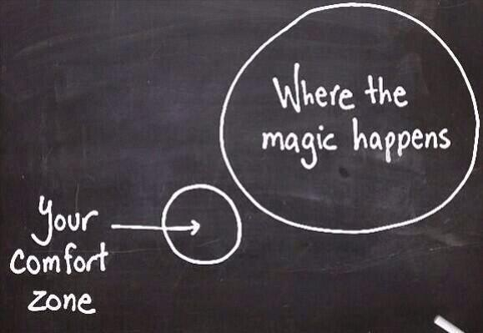

Slide 29
Theoretical Background:
Folkways
Established teaching practices which have come to be commonly accepted, and little conscious thought is put into their continued use and implementation (Buchmann, 1987).
Green - evidentiary and unevidentiary beliefs
Lortie - apprenticeship of observation
Pimm - unthought knowns
Tall - met befores

Slide 30
Motivation for the study:
“Math facts are a very small part of mathematics but unfortunately students who don’t memorize math facts well often come to believe that they can never be successful with math and turn away from the subject… for about one third of students the onset of timed testing is the beginning of math anxiety.” (Boaler, 2015)

Slide 31
Theoretical Background:
Useful tensions
Important to note that tensions can be useful for educators in shaping identity and practice (Lampert, 1985)
Tension may need to be deliberately introduced for a change in practice to occur (Liljedahl, 2014).
Berlak and Berlak (1981) suggest that because a person is capable of being made aware of tensions, they are capable of altering their practice.

Slide 32
Theoretical Background:
Tension between Action and Intent
between working towards a particular ideal and jeopardising that ideal by the approach chosen to attain it (Berry, 2007)

Slide 33
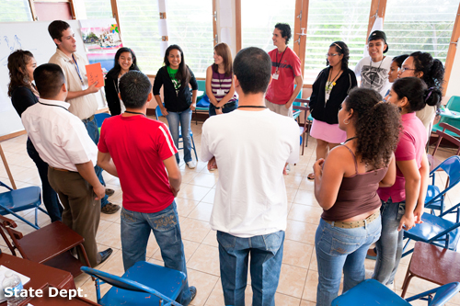

Slide 34
Research Question:
What is the transition process experienced by the preservice teachers as a result of the intervention?

Slide 35
Method:
Participants
69 pre-service teachers enrolled in two sections of a fourth year elementary mathematics methods course
Data
60 journal entries
pre-intervention survey
coded and analyzed using modified analytic induction

Slide 36
Results:
No tension between Action and Intent
Pre-intervention:
57 of the preservice teachers (n = 69) indicated that they would likely be using timed drills in their future classrooms
36 (n = 69) had used them during their practicums

Slide 37
Results:
No tension between Action and Intent
17 (n = 60) mentioned the enjoyment they experienced as young students participating in timed drills:
Julianne: I have grown up doing them (multiplication drills) and I don’t see them as an issue.
26 (n = 60) wrote about their negative experiences with timed drills as young students:
Cate: I have memories of having to spew out math facts as fast as possible. I hated it but I think it’s a good way to learn math facts.

Slide 38
Results:
2. Creating a tension between Action and Intent
Post-intervention:
47 of the preservice teachers (n = 60) wrote about the negative affect they felt when asked to participate in a timed drill
Jennifer: The minute you told us to stand up and that we will be doing multiplication questions; I went into a panic. My heart was racing, my stomach was clenching and I felt as if my brain was freezing.

Slide 39
Results:
2. Creating a tension between Action and Intent
Meryl: It’s definitely eye opening, having that memory from almost 20 years ago,and then the feeling of panic that I had when I thought that it was going to happen all over again in a university class.
Sandra: After you revealed that we actually weren’t going to do this activity, and we debriefed it, I realized just how unhealthy it was for me to think that this was a normal way of teaching.

Slide 40
Results:
3. Consequence of the tension on Action and Intent
Post-intervention:
51 of the preservice teachers (n = 60) stated that they would no longer be using timed drills in their future classrooms
Helen: When debriefing, I found it relieving and surprising to know how many other people felt the same way I did. Standing in a room full of adults who are becoming teachers, looking around at how much anxiety was caused by this one activity, I can only imagine in a room full of young students how they would feel.

Slide 41
Results:
3. Consequence of the tension on Action and Intent
Reese: As a teacher of mathematics, I will never force my students to do timed drills. After experiencing anxiety when you suggested we do this and seeing the anxiety it provoked in my peers, I was able to understand the anxiety that this causes in our students when we do the same to them.

Slide 42
Research Implications:
Interventions designed to introduce tension can be useful in unseating folkways of mathematics practice.
Disrupting the balance between action and intent may leave a void. The initial action (timed drills) is no longer satisfactory for reaching their goals. The intent to have students learn their basic facts remains but they will be searching for a new action to implement that will help them achieve that aim.
2. It would be interesting to follow-up on the lasting effects of this tension.

Slide 43
Ongoing Research:
Identify tensions that are specific to mathematics teachers
Further categorizing the tensions according to whether they are personal or pedagogical tensions, or possibly conflicts from external, systemic influences
Identify which tensions drive teachers to seek professional growth opportunities

