Slide 1
Inside teacher tensions: Examining their connection to emotions, motives, and goals
Annette Rouleau
PME 43
Pretoria, South Africa
July 7 – 12, 2019

Slide 2
Have you ever driven a vehicle with a manual transmission?

Slide 3
Learn to drive a manual transmission
Activity
Shifting gears, working the clutch
Conscious
Actions
Conscious Goal
Smooth coordination of clutch and gears
Check the seat, heat, rear view mirror
UnconsciousOperations
Conditions
Weather, time of day

Slide 4
Learn to drive a manual transmission
JOY
Activity
Motive
I want to drive to school!
Shifting gears, working the clutch
Conscious
Actions
Conscious Goal
Smooth coordination of clutch and gears
Check the seat, heat, rear view mirror
UnconsciousOperations
Weather, time of day
Conditions
Speed of the car, position of the gear stick

Slide 5
Learn to drive a manual transmission
Activity
Motive
I want to drive to school!
Conscious
Actions
Conscious Goal
Smooth coordination of clutch and gears
Shifting gears, working the clutch
UnconsciousOperations
Conditions
Speed of the car, position of the gear stick

Slide 6
Drive to school
Activity
Motive
Status
Plan route, parking
Conscious
Actions
Conscious Goal
Arrive safely and on time
Shifting gears, working the clutch
UnconsciousOperations
Conditions
Speed of the car, position of the gear stick

Slide 7
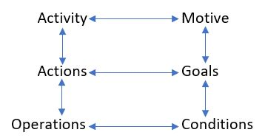
The activity hierarchy of Leont’ev (2009)
Activity theory is an approach that aims to understand individual human beings in their natural everyday life circumstances, through an analysis of their activities.

Slide 8
Activity is considered the key source of development of both the object and the subject.
This development occurs through “construction and resolution of successively evolving tensions or contradictions in a complex system” (Engeström, 1999, p. 384).
This is a dialectical understanding of tension in that tension is not considered as a point of failure in the activity, nor an obstacle to be overcome. Rather than ending points, tensions are starting places (Foot, 2014).

Slide 9
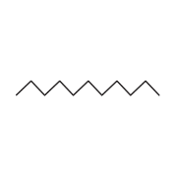
Tensions are essential for understanding the motivation behind particular goals and actions (Engeström, 2009).
Conflicting needs
and/or
Conflict between a need and the actions that are allowed to be done to satisfy it.
Action
Tension

Slide 10
Eric: I used to collect homework, but…
Homework
Activity
Motive
Assign, collect, grade
Conscious
Actions
Conscious Goal
Collect evidence of learning

Slide 11
Eric: He’d sit at the back and say “No, you’re wrong” or “I disagree” or “What about this?”.
And I loved it because there was this back and forth, and like this is good!
So, I think zeros, forget that. And man did he bring something to the [class].
I loved it.
So that really changed my philosophy on taking in homework.
Because he just sat there, but he was into it.
I thought this was great!
A lot of the students, all they do is just hand me homework, I like this better.

Slide 12
Eric: He’d sit at the back and say “No, you’re wrong” or “I disagree” or “What about this?”.
And I loved it because there was this back and forth, and like this is good!
So, I think zeros, forget that. And man did he bring something to the [class].
I loved it.
So that really changed my philosophy on taking in homework.
Because he just sat there, but he was into it.
I thought this was great!
A lot of the students, all they do is just hand me homework, I like this better.

Slide 13
Emotions are “internal signals” of the actualization of a motive or need (Leont’ev, 2009).
“to gain access to motives, one must proceed along a “round-about way,” by tracing emotionally marked experiences. In other words, the study of action-level emotional experiences is an avenue to an understanding of activity-level motives” (Engeström, 2009, p. 7).

Slide 14
Eric: I used to collect homework, but…
... there was no engagement.

Slide 15
1. Tension Changing Goals
~ Eric ~
Homework
Activity
Motive
Student engagement
Assign, collect, grade
Conscious
Actions
Conscious Goal
Collect evidence of learning

Slide 16
1. Tension Changing Goals
~ Eric ~
Activity
Motive
Student engagement
Conscious
Actions
Conscious Goal

Slide 17
Eric: I do know one thing after 10 years of collecting homework and marking, I don’t
want to do that anymore.
And so I'm trying to… I want to change.
I'm trying to fix that, but I'm still struggling with that.
So I'm going to make that my focus for the next year.

Slide 18
1. Tension Changing Goals
~ Eric ~
Activity
Motive
Professional Development
Conscious
Actions
Conscious Goal
Student engagement

Slide 19
2. Tension Prioritizing Goals
~ Lacey ~
Mathematics lesson
Activity
Motive
Independent worksheets and whole group instruction
Conscious
Actions
Conscious Goal
Classroom management and developing students’ mathematical understanding

Slide 20
Lacey: I knew now it wasn’t working. I realized I wasn’t happy with my math
program, but I didn’t know how to change it either.
“horrible feeling”
Mathematics lesson
Activity
Motive
Independent worksheets and whole group instruction
Conscious Goal
Classroom management and developing students’ mathematical understanding
Conscious
Actions
Classroom management and developing students’ mathematical understanding

Slide 21
3. Tension Strengthening Goals
~ Mia ~
Teaching
Activity
Motive
Collaborative problem solving, formative assessments
Conscious
Actions
Conscious Goal
To have her students enjoy mathematics and find it meaningful

Slide 22
Mia: It was really frustrating in that I had this idea of how I wanted to teach and
how I thought students should learn.
And especially after what I would consider a successful unit or a successful
lesson and then I would give them this formalized test that was the same as
all these other classes and then it actually meant little, because if the average
mark of the class wasn't 75%, then there was something wrong with my
teaching or my marking.
“stifling”
“I did [pushback], and that kind of eventually settled, but it was an issue.”

Slide 23
Mia: So, my colleagues are like, “This isn't right, the students need to know these steps.”
And I'd be like, why?
The students understand what they're doing and they're getting the right answer… like get over it.
“harassment”

Slide 24
Mia: The students were starting to stress out, “We have never seen this, what are you talking about? How are we supposed to do this? You never taught us
anything”.
They started to get angrier and angrier as the exam got closer.
And I don't know, like that really bothered me—in that okay, for my students,
like for their sakes, they do have an exam at the end and I wanted them to be
prepared for it.
And even though I could see that they had done some amazing math, they
never were aware of what they had done.
uncertainty and disappointment

Slide 25
Mia: And then what happened the following year when I had them [same
students] again, they started the year with some of that tension that was still
there, even though it sort of had settled over summer.
It was new curriculum, a new year.
But now they were like, “Well, what's this going to be about?”
And then I ended up teaching them very traditional.
Teaching
Activity
Motive
Building student relationships
Collaborative problem-solving, formative assessments
Conscious
Actions
Conscious Goal
To have her students enjoy mathematics and find it meaningful

Slide 26
Emotions reveal tension and motives.
However, it is important to note that emotions are not a reason to act, they are a result of activity (Leont’ev, 2009).
It is the tension itself that is vital to the subsequent changes in goals and actions.
Tension impacts goals: changing
prioritizing
strengthening

Slide 27
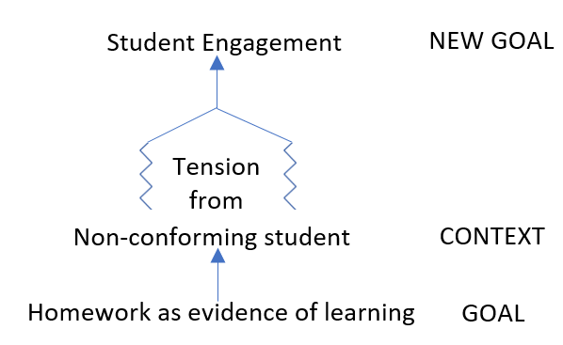
1. Context creates tension
Eric’s Goal Transformation

Slide 28
1. Context creates tension
Eric’s Goal Transformation

Slide 29
1. Context creates tension
Eric’s Goal Transformation

Slide 30
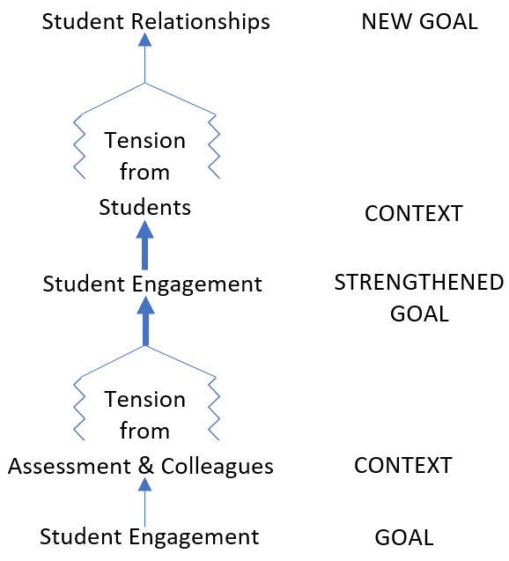
1. Context creates tension
Eric’s Goal Transformation
Mia’s Goal Transformation

Slide 31
1. Context creates tension
Eric’s Goal Transformation
Mia’s Goal Transformation

Slide 32
1. Context creates tension
Eric’s Goal Transformation
Mia’s Goal Transformation

Slide 33
1. Context creates tension
Eric’s Goal Transformation
Mia’s Goal Transformation

Slide 34
1. Context creates tension
Eric’s Goal Transformation
Mia’s Goal Transformation

Slide 35
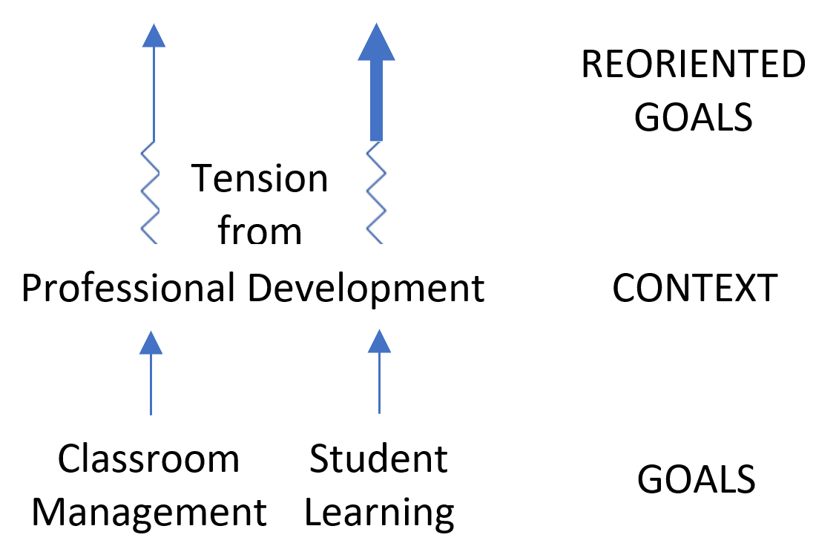
2. Tensions are useful in delineating primary and secondary goals
Lacey’s Goal Transformation

Slide 36
2. Tensions are useful in delineating primary and secondary goals
Lacey’s Goal Transformation

Slide 37
2. Tensions are useful in delineating primary and secondary goals
Lacey’s Goal Transformation

Slide 38
In this framing of the relationship between emotions, motives, and goals, tensions can be understood as drivers of teachers’ actions.
I see tensions as complex collections of opposing forces between possible actions and contrasting motives.
Tensions give rise to emotional responses that, in turn, make teachers conscious of their motives.
Tensions have an emotional nature and, consequently, they act as signals; the teacher feels, through tensions, that the motives of her actions are contradictory.
As such, tensions drive the teacher to action.

Slide 39
Thank you
annetterouleau.com
@annetterouleau

