Slide 1
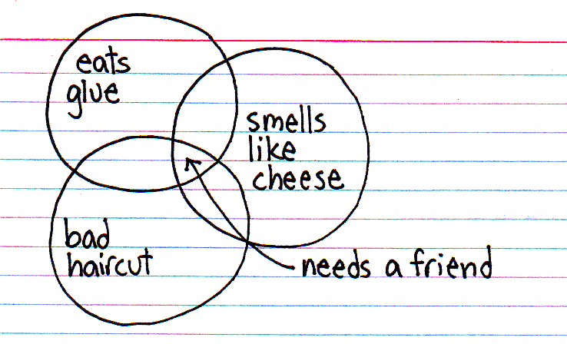
Teaching All students, not just those easiest to teach.
SCHOOL IMPROVEMENT
DIFFERENTIATED INSTRUCTION PROJECT
SCHOOL BASED PD DAY FEBRUARY 14/14
DIFFERENTIATION:
Image source: http://thisisindexed.com

Slide 2
Video source: http://youtu.be/aziNybUDDF0
Notes:
Video – 2:06 – Hillsong: Lord, I Lift Your Name On High
http://youtu.be/aziNybUDDF0

Slide 3
Reflection
1.
A stream without banks quickly grows into a very large puddle.
Banks provide boundaries and make it possible for a river
to flow freely and purposefully within those boundaries.
Call it a purpose. Call it a vision. Call it a preferred future state.
Whatever you call it, your vision channels your energy.
Your vision sets boundaries and provides focus.
Without focus and vision,
passion dissolves and zeal quickly evaporates.
Lord God, Holy Spirit, sharpen my vision,
granting me passion for your purposes.
May I serve my Servant-King with a
zealous heart, a heart on fire with love
for him and for those he still seeks.
Lord, we lift your name on high.
Amen
2.
3.
4.
5.
Notes:
1. A stream without banks quickly grows into a very large puddle.
Banks provide boundaries and make it possible for a river
to flow freely and purposefully within those boundaries.
2. Call it a purpose. Call it a vision. Call it a preferred future state.
Whatever you call it, your vision channels your energy.
Your vision sets boundaries and provides focus.
3. Without focus and vision,
passion dissolves and zeal quickly evaporates.
4. Lord God, Holy Spirit, sharpen my vision,
granting me passion for your purposes.
5. May I serve my Servant-King with a
zealous heart, a heart on fire with love
for him and for those he still seeks.
Lord, we lift your name on high.
Amen

Slide 4
Twitter
#gpcsd
Image source: thecuriousbrain.com/?p=37936
Notes:
A few housekeeping things first: Twitter feed
Log in.
Opens to home page.
Enter ‘#gpcsd’ into search bar.
Select ‘all’
That’s all… now you can watch the feed in real time.
Every once in a while, flip back to the Twitter feed (Alt Tab) to view any recent tweets.

Slide 5
DIFFERENTIATION
What have you taken aim at improving?
Notes:
Sharing at tables something new they’ve tried, seen, heard about.
Questions they have.
Successes, failures.

Slide 6
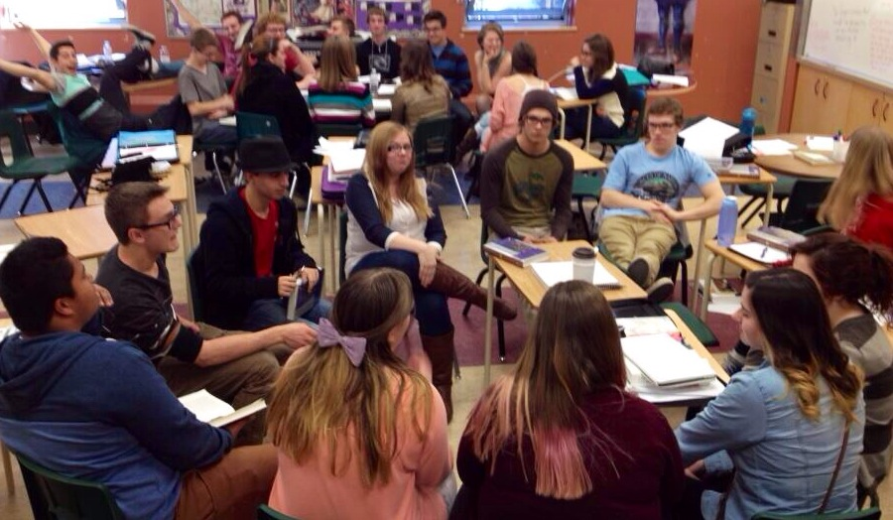
Differentiation is foremost a mindset.
Advice from Rick Wormeli:
Image source: Lisa Helm
Notes:
Wormeli says that in a successful differentiated classroom, we stop hiding behind the factory model of teaching.
We teach in whatever way students best learn, even if that’s different student to student, or different from the way we best learn ourselves.
Many of us are guilty of that from time to time – teaching the way we best learn.
Differentiation is highly effective teaching and we need to see it as more of a collection of principles – a mind set – rather than as a bag of tricks.

Slide 7
Wormeli says:
Build our own capacity for creative thinking
and problem solving.
Read and converse professionally.
Start small and be consistent.
Use our assessments to inform our
instructional decisions.
5. Think of teaching as something we do with students,
not to students.
Notes:
Remember to advance slide for each point to appear on-screen.
To do this Wormeli suggests we:
Build our personal capacity for creative thinking and problem-solving. Differentiation requires us to take risks, think divergently, and move out of comfort zones.
Wormeli says the best differentiation teachers he knows read professional journals, books and/or blogs regularly, and they take the time to discuss their ideas with colleagues in and out of their buildings. Multiple perspectives help us teach smarter, not harder.
Some of us think that we can’t do it all, so we end up not doing any of it. Instead, implement one differentiation idea per month for three years. Give yourself time and space to improve. You have license to be imperfect as you grow.
Spend considerable time demonstrating to yourself how your assessments (pre, formative, summative) inform your instructional decisions. You don’t just put students into small groups because that’s what you’re told differentiating teachers do; you do it specifically because of something you learned from an assessment.
The teaching/learning process is a collaboration between the teacher and the student.

Slide 8
Video source: http://youtu.be/eqRcpA5rYTE
Notes:
Video – 2:09 – Every Teacher Can Improve – Dylan Wiliam
http://youtu.be/eqRcpA5rYTE
After watching:
“Every teacher needs to get better…
every teacher has difficulties…
every teacher fails on a daily basis…
every single one of us needs to accept the commitment to carry on improving our practice until we retire or die… that’s the deal.”

Slide 9
Reflection
What do you do well?
More importantly,
where do you need to improve?
Notes:
Reflection transforms experience into genuine learning about individual values and goals.
It provides an opportunity for us to think critically about what we do and why.
And it encourages insight.
There are many ways to reflect but today we are going to try a quickwrite… spending time in the physical act of writing down our thoughts.
The act of writing helps us clarify those thoughts and forces us to focus on what’s important.
Don’t just list everything you wish to improve; that’s okay to get ideas flowing but then focus on one or two areas and write why you want to improve… what’s currently stopping you…
When I tried this I found myself writing about the things that I know deep down inside I should be doing, yet am not. I know best practice; I don’t always do it. Why is that?
This is a personal, private WRITTEN reflection… shared only if you wish.

Slide 10
Video source: http://youtu.be/YYnSKwaQxWM
Notes:
Video – 2:26 – Classroom Walk Through
http://youtu.be/YYnSKwaQxWM
Before:
Okay, that beginning part was a little heavy… it’s time for levity.
Although we can always find areas of improvement, we all have strengths and fortunately for us, our Principals are actually eager to come into our classrooms and see evidence of differentiated instruction.
After:
What changes will Principals have seen in yours since last September?
Pre-assessments?
Formative assessments?
Flexible grouping?
Student collaboration?
Student choice?
Anchor activities?
Tiered activities?

Slide 11
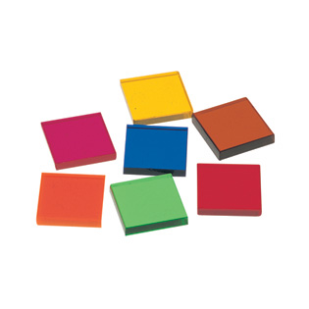
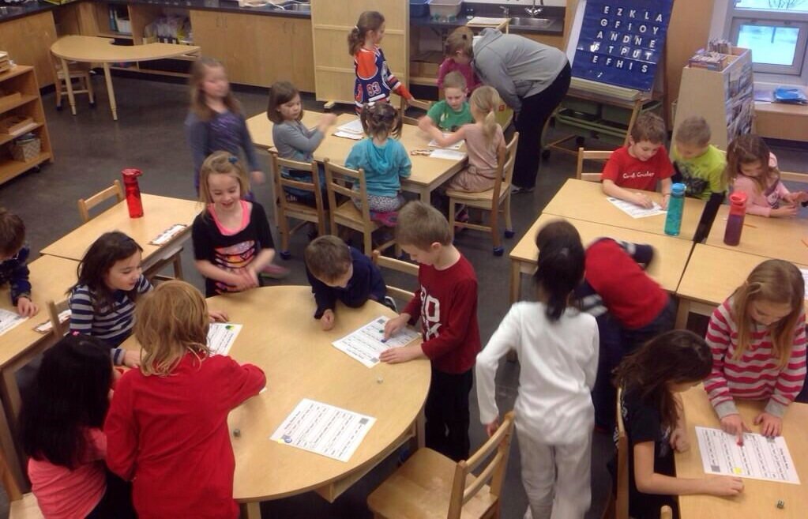
Anchor Activity
NIM
Video Source: www.learningresources.com
Image source: Roger Lauck
Notes:
Nim
Groups of two – 7 tiles/group
Alternating turns, each player can choose to remove one or two tiles.
Winner is the person who gets to take the last block(s).
Goal: Is there a way to ensure that you win every time?
Check for understanding by offering to play them.
First question: Who goes first? If they have no idea, or say it doesn’t matter, than you know they don’t have the correct strategy. Because if played correctly, whomever goes first will ALWAYS win.
The trick is to try and arrange it so that you can anticipate having three tiles at the end – whatever they pick – one or two – leaves you able to take the remainder.
Infinite variations for those that figure out 7 tiles:
11 – whomever goes first wins – same pattern
15 – whomever goes first loses
15 (taking 1, 2 or 3 tiles) – whomever goes first wins (anticipate groups of 4)
Alternatively, you could ask: Is there a number of tiles, that whomever goes first loses?

Slide 12
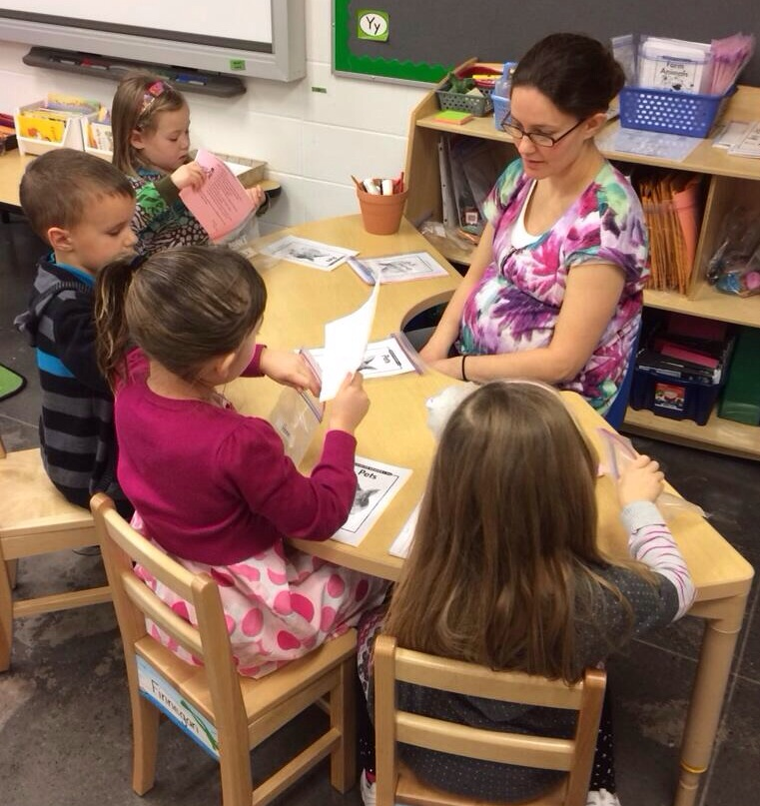
Formative Assessment
...the use of many small assessments to
drive our instruction rather than waiting until
the end when it may be too late.
…to allow teachers to adjust and refine
their instruction. ...to provide frequent and timely feedback for
our students.
Justin Tarte
Image source: Roger Lauck
Notes:
Integral part of the teaching/learning process
shouldn’t be for a grade
Formative assessment is like going to the doctor for a preventative check-up and finding out you have high blood pressure.
At this check-up, you would get feedback and input on how to lower your blood pressure.
Formative assessments keep you off the autopsy table when it’s too late to fix or prevent the damage. (Justin Tarte)

Slide 13
Formative Assessment Activity
Write down any number between 0 and 1000.
Just for fun… since we’ve been talking about numbers today:
http://www.worldometers.info/
Notes:
Have teachers write any number between 0 and 1000 on a piece of paper. Try not to show anyone.
Have all get up and find at least one other person that they can form a group with according to an attribute their numbers have in common. Try to keep strategy quiet.
Lead teacher circulates and gets stragglers into groups.
After almost all are in groups, halt the activity and have any ungrouped come to the front.
Show their number and see if any groups can fit them in.
Groups write their numbers down on whiteboard space.
Allow a couple minutes for people to walk around and privately guess a group’s attribute.
Gather whole group together in front of white space, and allow two guesses.
I usually start with who thinks they have an easy attribute? Difficult attribute?
Could use this in so many subject areas:
Draw a shape.
Write one of our spelling words.
Write an integer… irrational number… proper/improper fraction…
Write an algebraic expression.
Write an element.

Slide 14
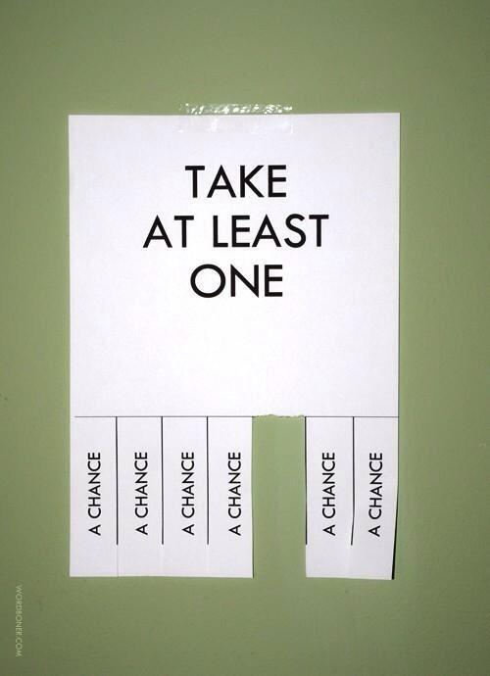
This Really Sucks!!
https://www.teachingchannel.org/videos/quick-classroom-warm-up
Notes:
Watch vid of teacher utilizing this strategy in a high school English classroom.
Then:
Whole group standing.
Designate one side of the room AGREE and the other DISAGREE.
As the next few slides appear they have to pick a side.
Each time, select one or two people from each side to offer their rationale.

Slide 15
This Really Sucks!!
Homework

Slide 16
This Really Sucks!!
Network Filters

Slide 17
This Really Sucks!!
Grade levels

Slide 18
This Really Sucks!!
Cell Phones
(in the classroom)

Slide 19
This Really Sucks!!
Grades and marks

Slide 20
Differentiation Scenarios…
he’s back!
Rick Wormeli gives us the following
scenarios to discuss.
In groups, discuss the following two
scenarios.
Ask yourself: Is it differentiation?
Why or Why not?
What would a highly accomplished
differentiating teacher do in this situation?
Image source: www.amazon.com

Slide 21
A student who seems to mix up decimal places and place value in his math problems is asked to do his work on graph paper, even on tests, thereby keeping his numbers clearly within their columns.
For a task that is particularly challenging for some students, the teacher announces they can just do as much of it as they can, then stop.

Slide 22
Video source: http://youtu.be/zYMs_1y2_gw
Notes:
Video – 1:10 – Do We Teach Like Dogs or Like Cats?
http://youtu.be/zYMs_1y2_gw

Slide 23
Afternoon Plan

Slide 24
References
Ferlazzo, Larry. (2012, January). Several Ways to Differentiate Instruction. Retrieved from
http://blogs.edweek.org/teachers/classroom_qa_with_larry_ferlazzo/2012/01/
response_ways_to_differentiate_instruction.html
Nunley, Katie. (2006). Differentiating the High School Classroom. Thousand Oaks, CA: Corwin Press.
Tomlinson, C & Eidson, C. (2003). Differentiation in Practice. Alexandria, VA: ASCD.
Tovani, Cris. (2011). So What Do They Really Know?. Markham, ON: Pembroke Publishers.
Wiliam, Dylan. (2011). Embedded Formative Assessment. Bloomington, IN: Solution Tree Press
Wormeli, Rick. ( 2007). Differentiation. Portland, ME: Stenhouse Publishers.
Wormeli, Rick. ( 2006). Fair Isn’t Always Equal. Portland, ME: Stenhouse Publishers.

