Slide 1
School improvement
Differentiated Instruction Project
2013-2014
Differentiation:
success for All

Slide 2

Education is not
the filling of a pail
but the lighting of a fire.
Author Unknown
Image source: wood-pellet-boilers.com
Notes:
This is the slide onscreen as everyone’s settling in.

Slide 3

Opening reflection
Video source: http://youtu.be/9nZkq31J-GY
Notes:
Video – 1:24 - The Story of the Starfish/Sea Star
http://youtu.be/9nZkq31J-GY
Before:
Going to start with a quick reflection.
This vid is about making a difference in any lives you touch.
An old story but worth hearing again.
After:
Say something cutesy about:
“here today to work together to make a difference… let’s be positive, enthusiastic, encouraging… let’s walk with God…”
You get the idea. I don’t do cutesy well; you’ll do it better.

Slide 4
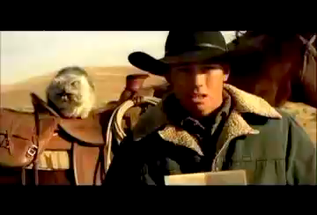
Video source: http://www.youtube.com/watch?v=1SmgLtg1Izw&feature=share&list=PLycZ1rGRTUiPdmpUOup2ScD2QcuPVTN8B
Differentiation:
“…when you get it right,
there ain’t a feelin’ like it in the world.”
Notes:
Video – 59s – Cat Herders
http://youtu.be/1SmgLtg1Izw
Before:
So it’s DI time again. Why DI? Because sometimes a teacher’s job is a little… who am I kidding?... a lot like herding cats… and we need to know and understand the best way to do that job effectively. Hence, DI.
After:
You know that feeling of when you got it right… just for that moment?
It’s incredible and sometimes we forget to celebrate those little successes.

Slide 5
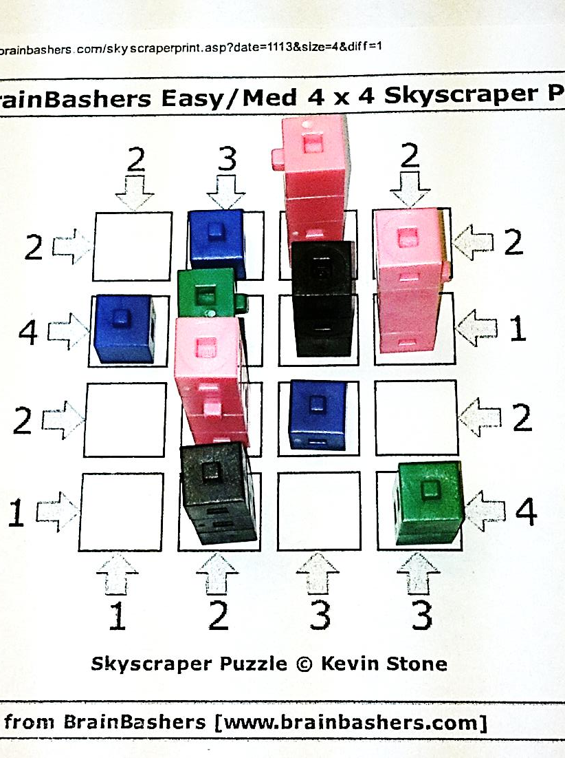
Anchor Activity
Skyscrapers
BrainBashers Daily Skyscrapers
Image source: Annette Rouleau
Notes:
Have all groups established before explaining or handing out paper.
Say the rules once - try not to overexplain. Require group members to explain to each other and figure it out together.
Rules / Objectives Summary:
1. Every square contains a skyscraper.
Complete the grid such that every row and column contains skyscrapers built out of 1 cube, 2 cubes, 3 cubes and 4 cubes.
3. Every row/column contains each size of skyscraper exactly once.
4. The rules around the outside tell you how many skyscrapers you can see.
5. You can't see a shorter skyscraper behind a taller one.
Have sheets of varying levels of difficulty.
Begin with groups of 4 or 5. One sheet per group. When whole group understands what to do, then allow working with elbow partners.
Complete Skyscraper anchor activity.
Then same group of 4 - vertical surfaces/chart paper – write everything you know about AA’s.
Gallery walk to steal ideas and add to own space.
Instruct group to choose three most important ideas they’d want to share with other teachers.
Whole group – share one idea each.
List on board.

Slide 6
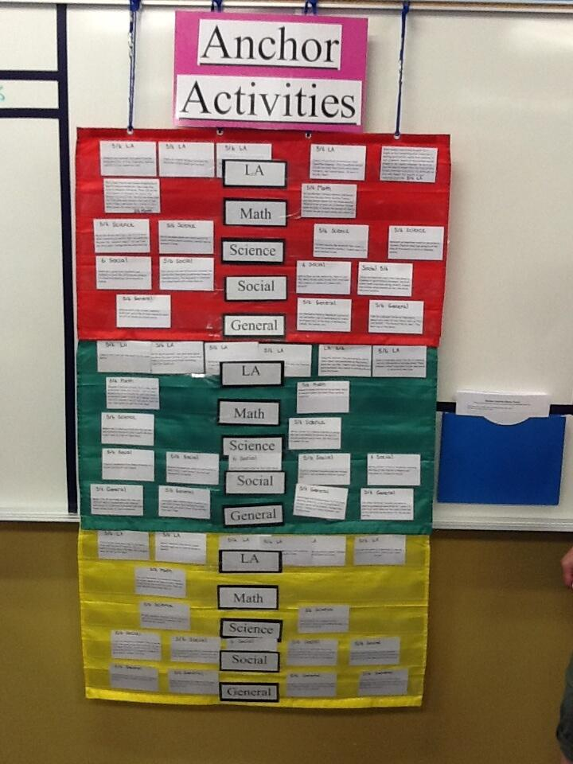
Anchor Activities
Offers choice
Provides meaningful work
For whole class or early finishers
Can be ongoing, long term projects
Curriculum related
Image source: Laura Tapson
Notes:
Rest assured they will have come up with something close to this or at least resembling it. This’ll just sum up what they’ve just come up with.
It’d be great if they came up with what AAs are not, too.
If you plan to change up the groups, now would be the time to do that… before the next slide.
And get them to the vertical surface/chart paper before giving the question.

Slide 7

Tiered Activity
How many squares are there on a chessboard?
NO GOOGLING ALLOWED!:)
Image source: whatculture.com
Notes:
Have all groups established and ready to go before giving question.
Initially give all groups same question.
Most groups will offer the answer 64 hesitantly… because they know that’s too easy. Quietly, to those groups say something like…”hmmm, I think there’s quite a few more”.
You won’t have time to get here but a group that gets the answer quickly would be given the “how many rectangles’ task.
You will need to pay attention today, many groups will need the chessboard image in front of them. I usually wait until I hear someone say, “I need a chessboard here!” and then quietly give them the image. Then another group notices and wants one.
If you see a group making a chart, comment on it or tell a struggling group, “you might want to see what they’re doing”.
You made need to suggest to some groups to try counting how many squares in a 1x1 board, then a 2x2 board, then a 3x3 board… until they notice a pattern.
Grade level – calculate how many squares on a chessboard - 204
Advanced level – calculate how many rectangles on chessboard – 1296
- can you come up with a formula that works for any size chessboard (nxn)
Early Readiness level – calculate how many squares on a smaller chessboard
Scaffolding for all - collaboration
- chessboard image as required by group
- gallery walks to encourage use of organizational chart
- encourage solving smaller, similar problem first

Slide 8
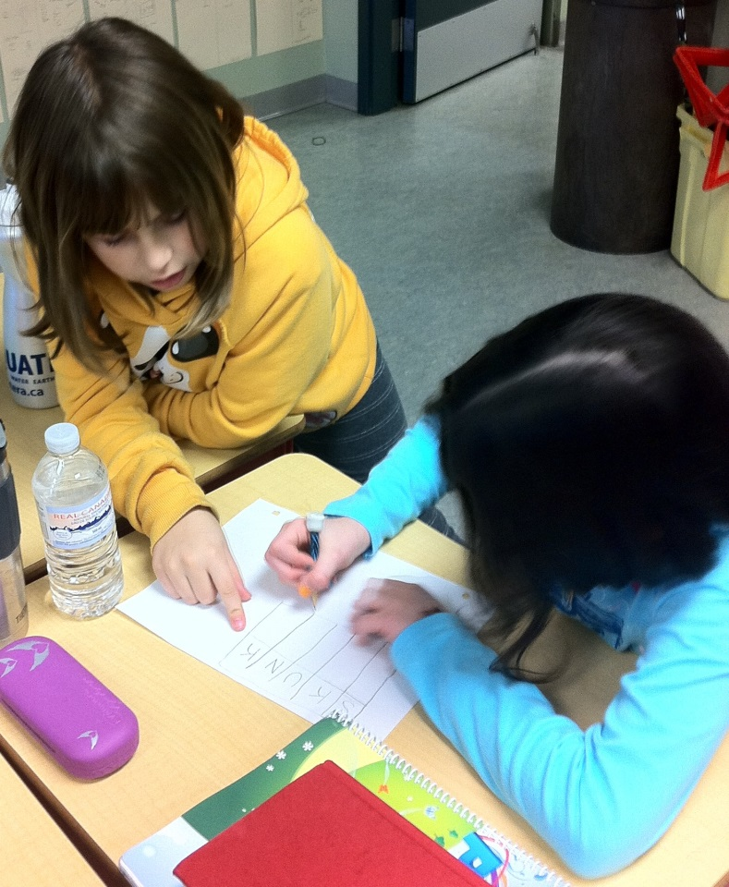
Tiered activities
Begin with the grade level expectation – raise and lower from there
Don’t have to tier every aspect
of every lesson
Won’t always have three tiers
Image source: Annette Rouleau
Notes:
Focus on low floor/high ceiling tasks…
this allows everyone a successful starting point
Wormeli – on tiering “Fair Isn’t Always Equal” p. 56
“emphasizes adjustments made according to students’ readiness levels, not interests or learner profiles, though these last two are critical elements of DI…”
(believes they are ‘lateral’ adjustments as opposed to tierings ‘vertical’ adjustments)

Slide 9
Tiering
Image source: Annette Rouleau
Notes:
Whole group:
Ask was the chessboard activity an example of a tiered activity?
(Explain what I set out as tiers.)
Give each person/pair/group a sticky note.
Quickly create 3 column chart on whiteboard – yes – no - sorta/kinda/maybe
Allow individuals to post sticky.
See if anyone is willing to discuss where they put their choice.
DON’T MENTION THIS AS AN EXAMPLE OF FEEDBACK YET.
Groups of 4 or 5 - vertical surfaces/chart paper – list barriers/obstacles to tiering.
Elbow partners – choose one and decide what advice you’d give to a teacher
Whole group – share advice

Slide 10
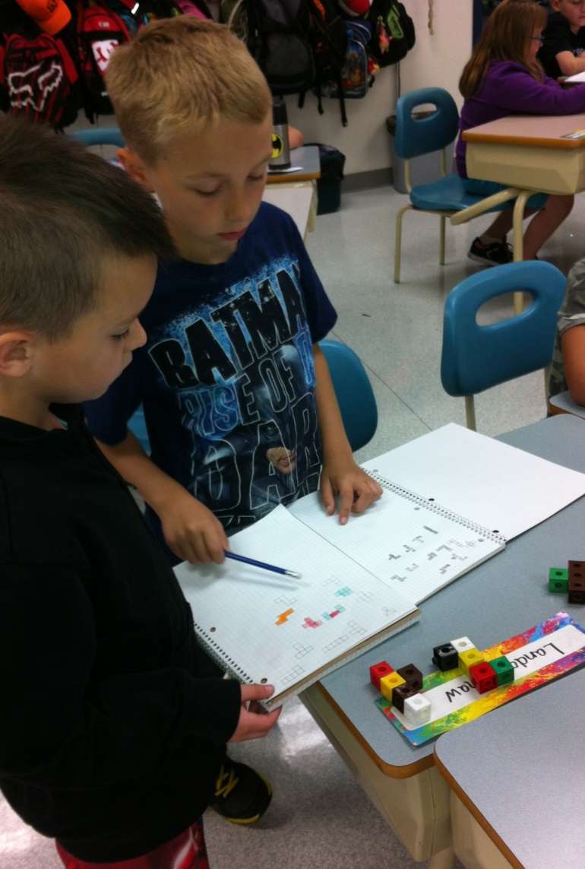
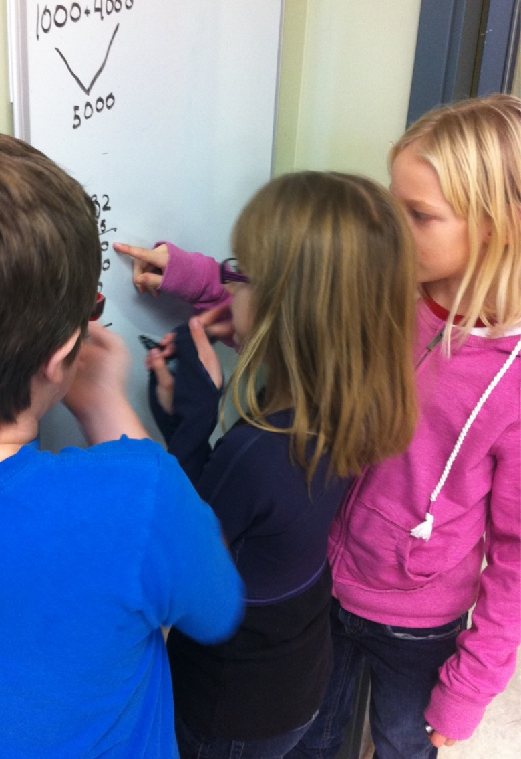
Flexible Grouping
Want students working AS a group, not IN a group.
Image source: Annette Rouleau
Image source: Annette Rouleau
Notes:
Whole group:
Picture two people working unhappily together – proximity, voice, body language (facial expressions, hands, movements), what are they saying/not saying
Create T-Chart on board. List attributes down one side.
Now picture two people working together unhappily – same parameters
List attributes on other side of T-chart.
Now add a third person to the unhappy group – anything change? (add to list)
Now add a third person to happy group - …
There, we’ve just created a group work rubric.
I use group work rubrics steadily for about a month then gradually decrease. I tell them something specific I might be focusing on that day (like proximity).
I begin with engaging, ‘fun’, collaborative tasks, in mixed ability groupings.
Use a lot of descriptive feedback for the behaviours you want.
Try, try try to use words like ‘notice’ rather than ‘like’, e.g., I noticed how you waited for Mark to speak.
If we want students working AS a group, not IN a group it HAS TO BE TAUGHT, MODELED, PRACTICED, VALUED.

Slide 11
Flexible Grouping
Whole group
Mixed ability
Similar ability
Independent work
Outwitted
He drew a circle to shut me out.
Heretic, rebel, a thing to flout.
But love and I had a wit to win
We drew a circle that took him in.
Edwin Markham
Notes:
Allows students to work together in a variety of ways, and in a number of arrangements.
Can be based on interests, readiness, learning styles, or randomly designed.
Dependent upon instructional activities, learning goals, and student needs.
Short term and changeable.
Benefits include increased student achievement and motivation, student ownership of learning, and growth in problem solving and communication skills.

Slide 12

Video source: http://youtu.be/rDHb3vC9OmE?t=11s
Notes:
Video – 1:17 – Brain Crack – Ze Frank
http://youtu.be/rDHb3vC9OmE
Before:
Study after study shows the benefits of collaborative work yet the tendency is still towards whole group instruction followed by independent seat work.
Why?
As this video says:
Like many good ideas we sometimes believe we don’t have the time or resources to do it right.
You can almost guarantee it (flexible grouping) will fail the first time…
… but somebody who does something bad three times still has three times the experience of that other person.
Sorry for the weird beginning, Ze Frank is one of Annette’s favourite vloggers, (which explains a lot about her!) but he’s definitely out of the box! Vloggers often get their ideas from Twitter or Reddit fans… this person just happens to have the Twitter handle “Hungry Hippo Licks Aunt Jemima”.
After:
Don’t get addicted to the idea of perfection. Get those good ideas out there and into practice.
If you plan to change up groups, now would be the time to do that… before the next slide.

Slide 13

Differentiation Scenarios
Rick Wormeli gives us the following
scenarios to discuss.
In groups, discuss the following two
scenarios.
Ask yourself: Is it differentiation?
Why or Why not?
What would a highly accomplished
differentiating teacher do in this situation?
Image source: www.amazon.com

Slide 14

Six students are identified as
advanced in a particular
subject, so the teacher
spreads them throughout
her student work groups so
they can help those who
struggle.
A student gets 100% on a pre-test so the teacher asks the student to do a personal research topic related to the general subject of the unit for the duration of their
studies.
Notes:
Allow discussion.
If you plan to change up the groups, now would be the time to do that… before the next slide.
and before handing out 11x17/chart paper.

Slide 15
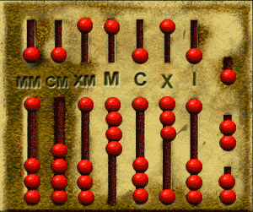
Formative Assessment
Not everything that
can be counted counts,
and not everything that counts can be counted.
Albert Einstein
Image source: imrl.usu.edu
Notes:
Pre-assessment
Placemat activity: 11 x 17 or chart paper
Groups of four divide paper into 4 sections with center title formative assessment.
Each person in the group takes 5 minutes to write down everything they already know in one of the sections. Name at the top of own section.
Draw line underneath when finished.
5 minutes to walk around and steal ideas.
Return to own placemat section, and using a different colour, add ideas you liked, forgot you knew, or were better worded.
Collect.
DON’T MENTION THAT THIS WAS A PRE-ASSESSMENT.

Slide 16

Video source: http://youtu.be/f6fUQ7IJZs8
Notes:
Video – 2:16 – Align, Assess, Achieve – Formative Assessment
http://youtu.be/f6fUQ7IJZs8
Before:
Listen to these thoughts about formative assessment. How do they fit with what you already know?
After:
Pre-assessment, flexible grouping and formative assessment are woven together.
Integral to all of them is feedback.

Slide 17

Feedback
The most powerful single innovation that enhances achievement is feedback.
Robert Marzano
Notes:
Feedback activity:
Gather group in large open circle.
Blindfold volunteer.
Place empty container somewhere in circle.
Give one person slip of paper with words: Good job! They are to say only those words when instructed – nothing else.
Give volunteer beanbag and tell them to throw it into the container.
NO ONE CAN GIVE ANY HINTS.
After first attempt, have person with slip of paper say: Good job.
Allow a few attempts with only verbal feedback being “Good job.”
New volunteer. Blindfold. Move container to new spot.
Give different person slip of paper with words: You need to throw it more to the left/right and further/shorter.
Give volunteer beanbag and tell them to throw it into the container.
Again, NO ONE CAN GIVE ANY HINTS.
After first attempt, person with slip of paper provides hints.
Allow a few attempts with verbal hints.

Slide 18
Feedback
Effective, descriptive feedback helps students to learn by…
•Providing information about current achievement
(where am I now?)
•With respect to a learning goal
(where am I going?)
•Identifying appropriate next steps
(how can I close the gaps?)
Notes:
My idea here was just having colleagues share thoughts about feedback - not do the quick research activity that you did.
Perhaps begin with sharing your own good/bad feedback experience – either as a student or as a teacher.
Or perhaps share an example of a written feedback statement.
e.g., All but one of your groups were working collaboratively while you were
working with a small group.
The off task group had finished early and weren’t sure what to do next.
Consider introducing anchor activities and/or add a line to your group work
rubric about what to do when a task is completed.
Instead of: Great job with flexible grouping. They were almost all working!

Slide 19
Feedback
Feedback should be:
Corrective in nature
Timely
Specific
Teacher and/or student-led
Notes:
Both verbal and nonverbal – in your actions and nonactions
Needs to be from others as well so that it’s not just teacher seeking behaviour.
Focus on what was done well, what needs improvement, and how to improve.

Slide 20
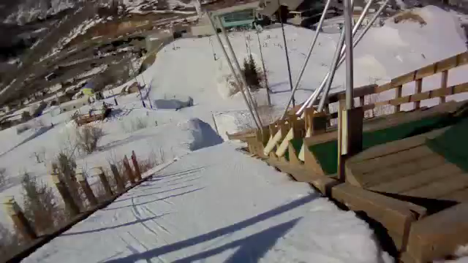
Video source: http://youtu.be/ebtGRvP3ILg
Notes:
Video – 1:49 – Girl’s First Ski Jump
http://youtu.be/ebtGRvP3ILg
Before:
DI may seem like too big of a challenge – outside of our skill set.
After:
But the end result is worth it.
Need new groups for exit card activity.

Slide 21
Exit Card
In groups, at vertical surfaces:
List any differentiation strategies modeled today.
Notes:
I’m a huge proponent of exit strategies for formative assessment.
They’re a quick way to check if the objectives have been mastered.
Today, I’ll let you work in groups.
Vertical surfaces/chart paper, quickly list any DI strategies I modeled today and in which activity.
Allow gallery walk and time to add to list.
Show how easy it is for students to take a picture of the board for personal use later.
Those who take horrible notes and then throw them away anyways, at least have a visual on their phone, those who rewrite their notes into perfection can still do so.

Slide 22
Afternoon Assignment
Continue to explore pre-assessment, flexible grouping,
anchor activities, and feedback.
Your task:
Find a WEB BASED article, blog, video that you find helpful
or entertaining or interesting or thought provoking…
and share with your collaborative group.
As a group, choose one you’re willing to share at our Dec 6/13 PD day.
Notes:
Emphasize the WEB BASED.
The rationale behind this is that many, many teachers forget to view the Internet as a source of quick, easy info.
You must have many colleagues coming to you asking for ideas about Anchor Activities… yet a quick search of the Internet can give them any info they might need.

Slide 23
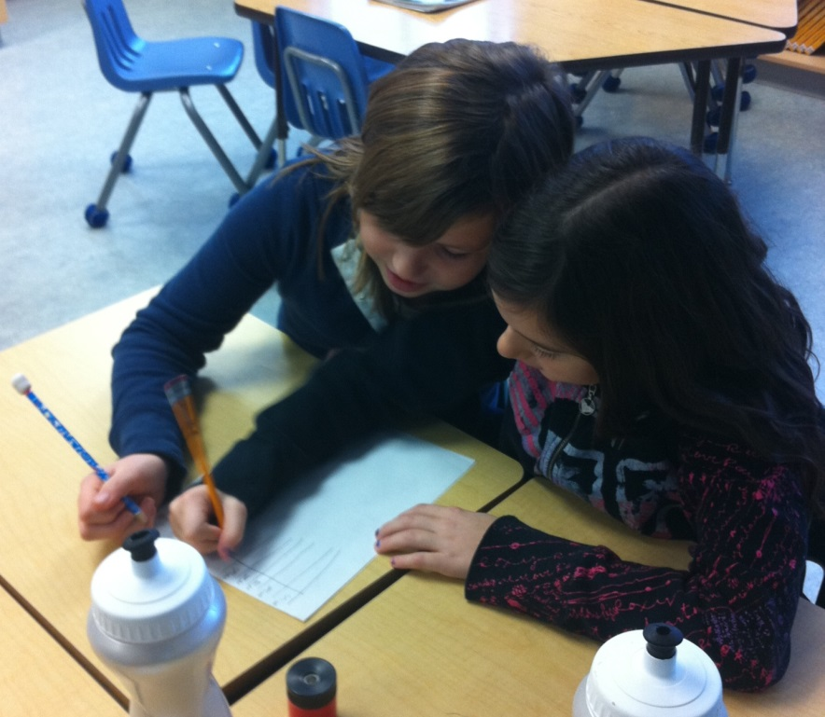
Lunch Reflection
Teaching is first and foremost learning,
and egocentric as it may sound,
the teacher’s chief area of study is herself or himself.
Only as I discover my own prejudices,
face my own fears, give play to my own strengths,
and compensate for my deficits rather than denying them
can I help my students to do the same.
It is both the blessing and the curse of teaching
that the learning never ends.
Every day, I must confront what I am as a teacher
and what I hope to be.
To do less is to be less of a teacher.
Carol Ann Tomlinson
Image source: Annette Rouleau

Slide 24
References
Nunley, Katie (2006). Differentiating the High School Classroom. Thousand Oaks, CA: Corwin Press.
Tomlinson, Carol (2001). At Work in the Differentiated Classroom. Alexandria, VA: ASCD.
Tomlinson, C & Eidson, C. (2003). Differentiation in Practice. Alexandria, VA: ASCD.
Tovani, C. (2011). So What Do They Really Know?. Markham, ON: Pembroke Publishers.
Valois, Megan (2013, August 21). Gathering Evidence of Learning VS Gathering “Marks”. Retrieved from
http://bit.ly/1fZIwsI
Wormeli, Rick ( 2006). Fair Isn’t Always Equal. Portland, ME: Stenhouse Publishers.

