Slide 1
School improvement Differentiated Instruction Project School Based pd Day December 6/13
Differentiation:
Teaching all students,
not just those easiest to teach.

Slide 2
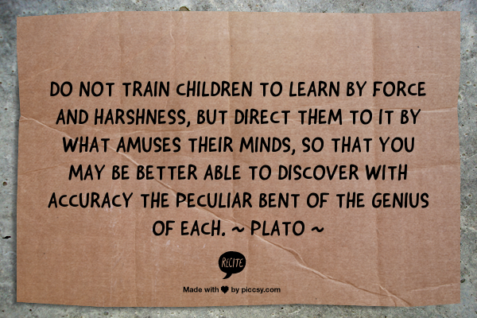
Notes:
This is the slide on-screen as they are arriving.

Slide 3
Twitter
#gpcsd
Image source: technorati.com
Image source: marketingpilgrim.com
Notes:
A few housekeeping things first: Twitter feed and prizes
Log in.
Opens to home page.
Enter ‘#gpcsd’ into search bar.
Select ‘all’
That’s all… now you can watch the feed in real time.
Every once in a while, flip back to the Twitter feed (Alt Tab) to view any recent tweets.
FOR A LITTLE FUN:
The first person to shout out good job when they see the Twitter bird on a slide wins a prize.
Qualifier – they must turn the ‘good job’ feedback into descriptive feedback about your presentation.

Slide 4
Reflection
Video source: http://youtu.be/xcmI5SSQLmE
Notes:
Video – 1:55 – Obvious to You, Amazing to Others
http://youtu.be/xcmI5SSQLmE
Before:
Going to start with a quick reflection.
After:
DI isn’t something ‘new’, some new reform…
it’s not a tidy little package that can be handed over..
Lots of us already do bits and pieces of DI… with varying degrees of success
And I’m not here to tell you that you need to change everything about your teaching practice.
I’m asking you to keep an open mind today… allow yourself to participate… and view everything I ask of you from both the lens of a teacher and as a student
When I present, I am passionate and open and honest. I truly believe in what I have to say and that will come through today, I’m sure… This is who I am, it is how I teach. And once I really began seeing the individual child in front of me, with his or her individual needs, it transformed my teaching. I want to share that experience with you. And I want you to share your experiences with me and everyone else.
What I am here to say is that the best way to grow our teaching practice is through collaboration with others – there are people doing amazing things in their classrooms that to them are quite ordinary… but we never hear about it

Slide 5
The smartest person in the room… is the room.
~David Weinberger
Since our last school-based PD:
What DI strategies have you tried out?
How have you altered a lesson?
What worked? Didn’t work?
Individual
Reflection
Partner
Share
Room
Share
Notes:
So what’s obvious to you is amazing to others:
1. Individual reflection:
Allow time for silent, individual reflection on changes they’ve implemented since
the last PD day. Can be successes or things that didn’t go quite as planned!
Have to share this thought from Kristie Lorenz about getting students up and
moving: “I stand all day and I’m brilliant!”
2. Partner share:
Have them share with someone beside them.
3. Room share:
Have them up and moving, finding at least one other teacher to share with.
This teacher CANNOT be someone from their table.
Whole group reflection:
Why time for individual reflection before sharing?
Why time for partner sharing before room sharing?
Why do room sharing?

Slide 6
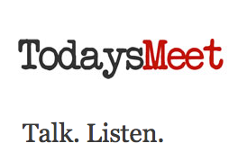
Today’s Meet
Notes:
Model how easy it is to create a room.
Write the URL up on the whiteboard.
(I usually create the room ahead of time
and put up a QR code for easier access.)
Pitfalls: inappropriate comments – must build
the culture first
Demonstrate how to enter name.
and selecting join by actually entering
your own name.
3. Type in one strategy you’ve tried.
Select ‘say’.
Now have every teacher navigate to the site on their phones/iPads
and enter an anecdote they shared or was shared with them.

Slide 7
Thinking About the Deep Structures of School
The DI wheel:
We don’t need to reinvent it;
We need to learn how to roll it.
Image source: http://www.presentermedia.com/
Notes:
Reflecting back on the conversations and pre-assessments collected at the last PD days made me realize that all of us seem to have a really good grasp on the fundamentals and theory behind DI yet I’m not convinced we’re actually implementing elements of it successfully into our teaching practice.
It’s always easier said than done.
This will be a vertical surface, random group activity.
I’m going to ask you to make a line continuum with agree/disagree at opposite ends.
I’m going to show some statements and I want your group to discuss the degree to which you believe these statements and place on the continuum. (either statement # or just a word). Make your line near the top of your board.
Random group.
Show statements.
Now, we’re going to repeat this but this time I want your group to discuss the degree to which what you see in our schools suggests we believe them.

Slide 8
1. Teaching as telling

Slide 9
2. Curriculum as coverage of facts and skills.

Slide 10
3. Students as dependent.

Slide 11
4. Lessons directly linked with learning goals.

Slide 12
5. Instructional strategies as a ‘bag of tricks’.
Notes:
Can’t just take what someone else does and implement it. It has to be purposeful.
e.g., my thoughts about vertical surfaces

Slide 13
6. Assessment as what comes at the end to ‘see who got it’.

Slide 14
7. Classroom management as a synonym for control.

Slide 15
8. Fair as treating everyone alike.

Slide 16
Jay McTighe on Critical Transformations
Video source: youtu.be/dSSeuem6BLA
Notes:
Video – 1:24 - Jay McTighe on Critical Transformations
http://youtu.be/dSSeuem6BLA
That’s what we all want from our students:
“…not tell me what you know in a factual, recall way but
show me what you can do with the meanings you’ve made.”
Does the way we teach allow for that to happen?

Slide 17
Tiered Activity
Video source: http://youtu.be/cJ7A0yTDiqQ
Notes:
Video – 3:58 - When Was It A Million Seconds Ago
http://youtu.be/cJ7A0yTDiqQ
Before showing vid:
Each teacher needs a piece of paper in front of them and something to write with. They DON’T need to put their name on the paper.
Explain that they will be watching a short segment of a video, which will pose a question…. at which point the video will be paused. (~00:56 seconds)
They are to answer the question immediately, quickly writing their answer down.
Emphasize that there is little personal risk about their answer:
- no one will know they wrote it
- they won’t be asked to share it with someone close by
I stole this idea from Rachel Chauvet: Have everyone stand up and crumple up their papers.
On your mark, they are all to throw the paper at someone, then pick up a different one
Repeat for three throws.
Stop the throwing and have everyone find a paper and pick it up.
Remain standing. Have volunteers shout out the answer on their paper. Write on board.
Back to tables. Have groups/partners calculate the real answer, using any tools they want but they must show their work.
Whole group:
Super important to explain that in the classroom this activity would have been purposefully grouped
into likeabililty groupings.
Low group would be asked to solve a smaller problem – 100 s, 1000 s…
High group, when finished, would be asked to first guess and then work with numbers that manipulate the decimal placement
e.g., 10 000, 100 000, 1 000 000.
8. Watch end of video, if you want… stop it at the pumpkin part.

Slide 18
Tiering
The process of adjusting the degree of difficulty of a question, task, or product
to match a student’s current readiness level.
Begin with the grade level expectation – raise and lower from there
(Tomlinson & Eidson, 2003)
Notes:
For background info – read p. 55 – 61 Rick Wormeli book
- PDF What Do Students Need? Diane Heacox
- article Tiering and Scaffolding: Lori Williams
My problems with tiering:
I tend to focus on low floor/high ceiling tasks, which allow everyone a successful starting point. I then support lower groups and use questions to push to challenges.
I seldom start out kids on separate activities (except when I’m working with a small, likeability group or one-on-one). I get everyone started on a task and then individually address the groups whose task will be raised or lowered.
Some tiering info seems to indicate that advanced tasks should originate higher up on Bloom’s while basic tasks start lower – I STRONGLY disagree
Notes to remember:
- tiering is working where they’re at – scaffolding is getting them to a set point
- you REALLY need to know your curriculum
tiered activities can be used individually or in likeability groups
It’s different work – not more or less work
e.g., don’t do: basic task: read 2 short stories and compare/contrast
advanced task: read 3 short stories and compare/contrast

Slide 19
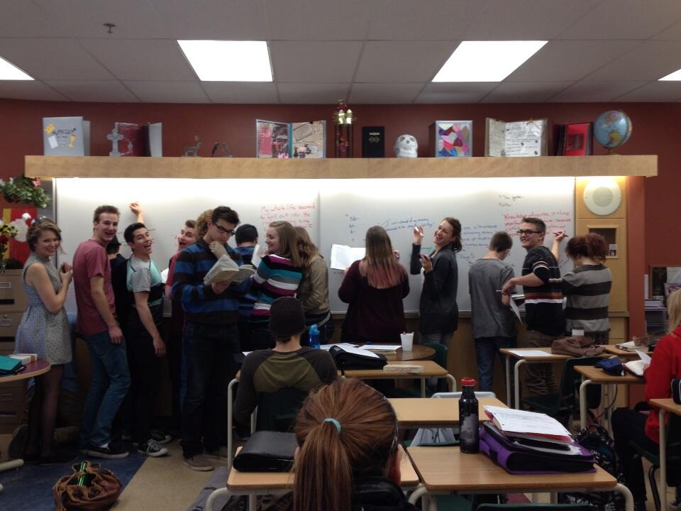
Pre-Assessment
You need to have more than a gut feeling of
what students know or can do
before deciding how to take them farther.
Image source: Lisa Helm
Notes:
Random group. Vertical surfaces.
Quickly list as many pre-assessment tools/strategies as you can.
On-going gallery walk to steal ideas throughout activity.
Have everyone sit back down.
Declare a winner – announcing that you’re not even going to double-check because pre-assessments come in many varieties according the task, situation, grade, subject…
Now say: We obviously have a vast store of pre-assessment best practice… which begs the question of why? Why don’t we use it?
Share a story here of your own struggles/successes with pre-assessment.
[Personally, I, uh, may have always gone with my ‘gut’ feeling :(
Or I do a pre-assessment… and do nothing with it after!]

Slide 20
Pre-Assessment
WHY?
to gain an understanding of what your students:
know
understand
are able to do
Purposeful planning
Purposeful grouping
Image source: http://www.presentermedia.com/
Notes:
Plan learning activities that address varying levels of readiness
To make instructional decisions about student strengths and needs
Purposeful grouping
To determine which students are ready for advance instruction

Slide 21
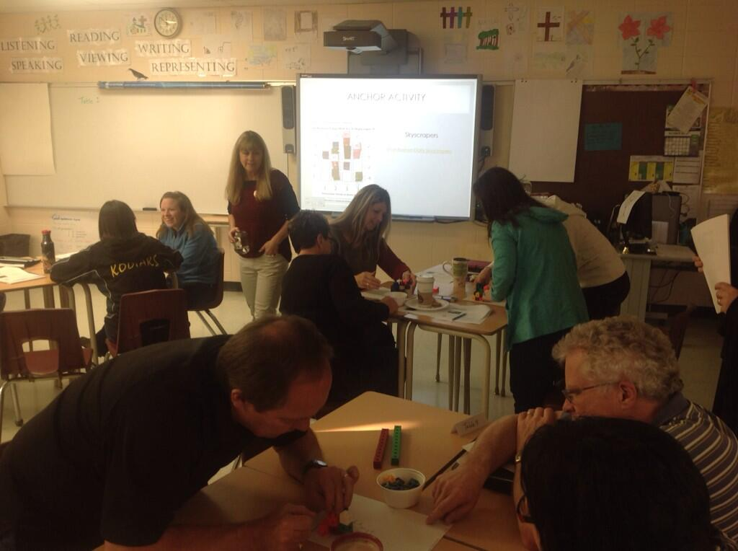
Flexible Grouping
Think of it as “PURPOSEFUL GROUPING”…
because it shouldn’t always be random.
Image source: Amanda Gilmore
Notes:
Want students working AS a group… not IN a group.
Groups formed according to student interests, readiness, and learning styles.
Just like pre-assessments they are dependent upon the task, objective, and student needs.
Let’s Politely Disagree Activity:
Divide into two groups (A & B). Further divide each group in half (A1, A2 & B1, B2).
Groups A1 & A2 are focusing on pre-assessment.
Group A1 is to come up with reasons we should pre-assess and be prepared to rebut reasons we shouldn’t/barriers.
Group A2 is to come up with reasons/barriers against pre-assessment and be prepared to rebut why we should.
Groups B1 & B2 will do the same for the topic flexible grouping.
To run the debate:
A member of A1 makes their first statement. A member of A2 politely says why they disagree and then says their statement. Next member of A1 rebuts that statement and then says her prepared statement.

Slide 22
Feedback as Part of Formative Assessment
Feedback needs to come while the students still think of the learning goal as a learning goal –
that is, something they are still striving for, not something they already did.
(Brookhart, 2008)
Image source: http://www.presentermedia.com/
Notes:
Good feedback gives students information they need so they can understand where they are in their learning and what to do next – the cognitive factor.
Once they feel they understand what to do and why, most students develop a feeling that they have control over their own learning – the motivational factor.
The research on feedback shows that much of the feedback that students receive has, at best, no impact on learning and can actually be counterproductive because it is usually summative, rarely formative.
The most effective form of feedback was that which told students not just how to improve but also how to go about it… and it didn’t have an accompanying grade attached.
It was found that “grades with comments are no more effective than grades alone, and much less effective than comments alone.”
(in case someone asks: The research quoted here comes from a research brief called “Five Key Strategies for Effective Formative Assessment” published in 2007 by the National Council of Mathematics. It is based on the work of Dylan William.)

Slide 23
Nobody really does this… right?
Video source: youtu.be/0fn_vAhu_Lw
Notes:
Video – 2:01 Mr. D
http://youtu.be/0fn_vAhu_Lw

Slide 24
Differentiation Scenarios… he’s back!
Rick Wormeli gives us the following
scenarios to discuss.
In groups, discuss the following two
scenarios.
Ask yourself: Is it differentiation?
Why or Why not?
What would a highly accomplished
differentiating teacher do in this situation?
Image source: www.amazon.com

Slide 25
A teacher hands back an ungraded math sheet on which is written: ‘You seem to be confusing sine and cosine. Talk to Katie about how to work out the difference.’
Worried about how well her students will perform on an upcoming summative assessment, a teacher decides to formatively assess their skills the day before they have to write the test.
Notes:
Allow discussion.
A: good descriptive feedback – tells student what the target is (understanding sine &
cosine) and how to get there (ask Katie). What it lacks is an indication of where
the student is right now. Now the follow-through is that the student needs to be
given time to work with Katie before being reassessed formatively.
B: Assessing skills/knowledge the day before they are to be summatively assessed is
NOT formative… the student won’t have time to learn/relearn.
However, if as a result of this assessment, the teacher decides to move the date of
the summative (for some learners) in order to have time to reteach then it could
be a useful formative assessment.

Slide 26
Final Reflection
You can know the name of a bird in all the languages of the world,
but when you're finished,
you'll know absolutely nothing whatever about the bird...
So let's look at the bird
and see what it's doing — that's what counts.
I learned very early the difference between
knowing the name of something and knowing something.
~Richard Feynman
Notes:
I think we’re all pretty good at naming good DI practice but what do we really know about it?

Slide 27
References
Brookhart, Susan. (2008). How to Give Effective Feedback to Your Students. Retrieved from
http://is.gd/RIqRpK
Heacox, Diane. (2001, October). What Do Students Need?. Retrieved from
http://www.pps.k12.or.us/files/tag/What_Do_Students_Need-Ch_6_Diane_Heacox-foundation_secondary.pdf
Nunley, Katie. (2006). Differentiating the High School Classroom. Thousand Oaks, CA: Corwin Press.
Tomlinson, C & Eidson, C. (2003). Differentiation in Practice. Alexandria, VA: ASCD.
Tovani, Cris. (2011). So What Do They Really Know?. Markham, ON: Pembroke Publishers.
Williams, Lori. (2008 February). Tiering and Scaffolding. Retrieved from
http://extensionsmath.pbworks.com/f/NCTM+Tiering+and+Scaffolding.pdf
Wormeli, Rick. ( 2007). Differentiation. Portland, ME: Stenhouse Publishers.
Wormeli, Rick. ( 2006). Fair Isn’t Always Equal. Portland, ME: Stenhouse Publishers.

