Slide 1
The problem human beings face is not that we aim too high and fail, but that we aim too low and succeed.
Michelangelo
Differentiation:
Teaching all students,
not just those easiest to teach.
School Improvement Differentiated Instruction Project
School Based PD Day May 16/14
Notes:
Begin with your usual welcome and mention that we’re beginning with a song and prayer.
The song is accompanied by pictures of students in our schools that have been tweeted out over the past year.

Slide 2
Retrieved from: http://youtu.be/hw1pxXJUUZw
Notes:
Video - #gpcsd Twitter Pics 2014 – 3:58
http://youtu.be/hw1pxXJUUZw

Slide 3
The Serenity Prayer
God, give me grace to accept with serenity
the things that cannot be changed,
Courage to change the things which should be changed,
and the wisdom to distinguish the one from the other.
Living one day at a time,
Enjoying one moment at a time,
Accepting hardship as a pathway to peace,
Taking, as Jesus did,
This sinful world as it is,
Not as I would have it,
Trusting that You will make all things right,
If I surrender to Your will,
So that I may be reasonably happy in this life,
And supremely happy with You forever in the next.
Amen.
--Reinhold Niebuhr
Notes:
Preselect four volunteers to read a section aloud.
Give them each a copy with their section highlighted.
This is just for your own info:
The Serenity Prayer is the common name for an originally untitled prayer by the American theologian Reinhold Niebuhr[1] (1892–1971). It has been adopted by Alcoholics Anonymous and other twelve-step programs.
Though clearly circulating in oral form earlier, the earliest established date for a written form of the prayer is Niebuhr's inclusion of it in a sermon in 1943, followed closely by its inclusion in a Federal Council of Churches (FCC) book for army chaplains and servicemen in 1944.

Slide 4
Twitter
#gpcsd
Notes:
Encourage use of Twitter again.
The blue #gpcsd is linked directly to the gpcsd hashtag.
You don’t need to worry about signing in.

Slide 5
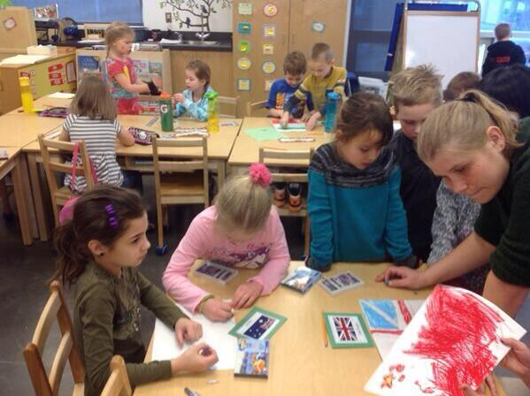
Anchor Activity
KidCala
Image source: Roger Lauck
Notes:
Gather whole group at large table to explain activity.
But don’t just read the info below out loud – explain it in your own words.
Mancala is a family of board games played around the world, sometimes called "sowing" games, or "count-and-capture" games, which describes the gameplay. The word mancala comes from the Arabic word naqala meaning literally "to move." More than 800 names of traditional mancala games are known, and almost 200 invented games have been described.
The game employs a board of 12 holes called "bowls" and two stores at both ends called "mancalas".
At the start there are four small objects in each hole.
On each turn, a player distributes the contents of one of his holes, one by one, in the counter-clockwise direction into the succeeding holes and both mancalas.
If the last object is dropped into the player's own mancala, he gets to move again.
The turn is over, if the last object falls into a bowl or the opponent's mancala.
The game ends when all bowls of a player are empty.
http://www.howcast.com/videos/210328-How-to-Play-Mancala
This is a link to the actual mancala game. I play a slightly different version called KidCala so the ending is a lot different. Ignore the video rules from step five on!
After playing:
Think, pair, share – Why gather first to explain? Why would we do this activity? Why have anchor activities?

Slide 6
Retrieved from: http://youtu.be/DcziMI0tol4
Notes:
Video: If I Take One More Step – 51 seconds
http://youtu.be/DcziMI0tol4
Today’s theme is change…
embracing change,
fighting change,
wondering why we have to change,
wondering if we need to change –
And why now? Why are we in this vortex of change right now?
It’s not just our division either – education is at the forefront of change – think Inspiring Ed!
Change rocks our foundations – destabilizes us.
Bilbo tells us that if we don’t keep our feet there’s no knowing where we might get swept off to.
So just like Sam and Frodo, we do it together.
We collaborate and support each other; learning together along the way.
Some days it may feel as if you’re headed to Mount Doom in Mordor
but our true goal is, and always has been, the path to what’s in the best interest of the child in front of us.

Slide 7
Embracing Change
Change has a considerable psychological impact on the human mind.
To the fearful,
it is threatening because it means that things may get worse.
To the hopeful,
it is encouraging because things may get better.
To the confident,
it is inspiring because the challenge exists to make things better.
~ King Whitney Jr.
Notes:
I thought a lot about this quote… trying to categorize myself and seeing where I thought I fit in.
Turns out my best fit is all three. When I reflect on my practice, I know that I am all three depending upon the moment.
I am confident about change when I have a great task and I’ve found a new web tool that will extend the learning even further.
I am hopeful when someone shares an assessment with me that helps me step further away from reliance on a traditional unit test.
I am fearful when I think about having to give up those habits I rely on even though I know deep down inside that I’m not reaching my students – like copying board notes.
This shocked me a bit because I always think of myself as someone who embraces change.
Not just change for change sake but change that I believe is in the best interest of learning. But even when I know that the change is purposeful; I still resist.
I need to be convinced and I need time to think and accept.
I need to reflect.
Table/group discussion

Slide 8
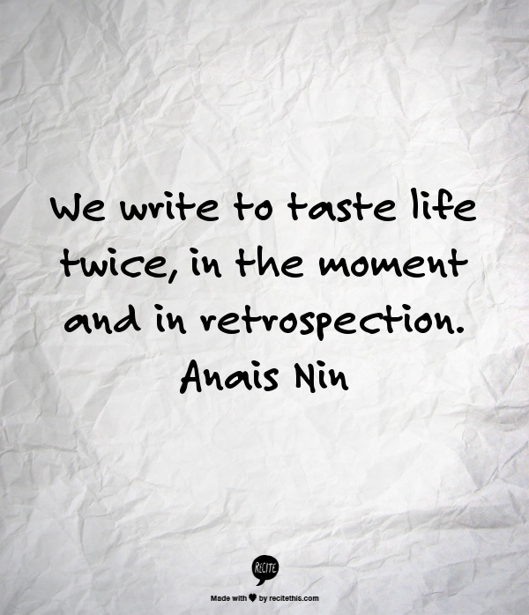
Reflection
What do you do well?
More importantly,
where do you need to improve?
Notes:
There are many ways to reflect but today we are going to try a quickwrite…
I’ve used this activity as a formative assessment with students. For example, tell me everything you’ve learned so far about Self-image in health or Light and Shadow in science. I set a time limit and I emphasize the importance of not stopping writing, let the thoughts flow out exactly as they cross their minds.
So today we’re going to spend time in the physical act of writing down our thoughts.
Reflection transforms experience into genuine learning about individual values and goals.
It provides an opportunity for us to think critically about what we do and why.
And it encourages insight… and with insight comes the willingness to change.
The act of writing helps us clarify our thoughts and forces us to focus on what’s important.
Don’t just list everything you wish to improve; that’s okay to get ideas flowing but then focus on one or two areas and write why you want to improve… what’s currently stopping you…
When I tried this I found myself writing about the things that I know deep down inside I should be doing, yet am not. I know best practice; I don’t always do it. Why is that? Why do I resist change?
This is a personal, private WRITTEN reflection… shared only if you wish.

Slide 9
Shift in Assessment Use
Teach
Test
Grade
Move on
Assess
Assess
Assess
Teach
Adjust Instruction
Notes:
The images in this slide will appear one by one as you click.
You decide when you wish to talk and when you want images.
Dylan Wiliam – What Assessment Can – and Cannot – Do.
Quite obviously, assessment is central to education.
If only students learned what we taught, we would never need to assess; we could just keep records of what we taught.
Actually, sometimes when we look at their work, we wonder if they were even present in our classroom!
We can’t predict with certainty what students will learn in a particular lesson nor which students will learn it.
And we know that each student starts out at a different point and each will arrive at different understandings.
So we assess.
Assessment is that bridge between teaching and learning.
It is only through assessment that we can find out whether what happened in the classroom has produced the learning we intended.
But in order to teach well we need to assess frequently to let it guide our instruction.
We cannot and must not wait until the end.

Slide 10
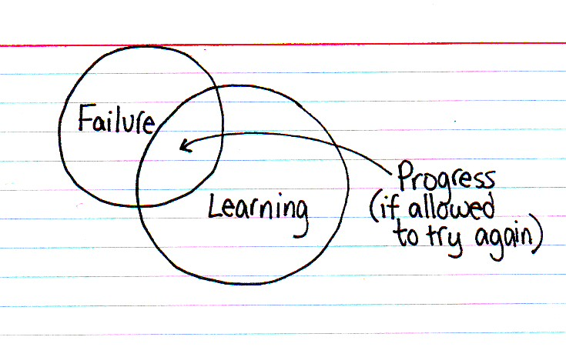
Formative Assessment
…the use of many small assessments to
drive our instruction rather than
waiting until the end when it may be
too late.
…to allow teachers to adjust and refine
their instruction.
…to provide frequent and timely
feedback for our students.
Justin Tarte
Image source: http://thisisindexed.com
Notes:
The bullet points will appear one by one as you click.
The stars indicate the words you might say as each new bullet appears.
Traditionally, assessment has been seen as a way of finding out what students have learned.
*
In DI, assessment is viewed as a way to enhance student learning instead of just measuring it.
*
To do this, assessment needs to be ongoing and it must drive instruction.
This means that a teacher decides when a student is ready to move on based upon what he or she has learned about what the student already knows and can do.
The only way to do this is frequent formative assessment.
*
It’s any method that shows you what the student learned… or equally important, didn’t learn.
It shouldn’t be graded but must be shared with the students so they understand where there are gaps in their learning.
Table/whole group discussion: Are we doing this in our classrooms? Why? Why not?

Slide 11
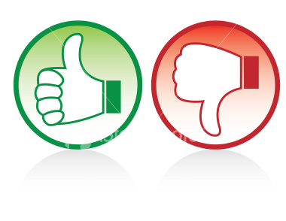
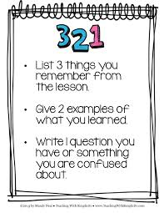
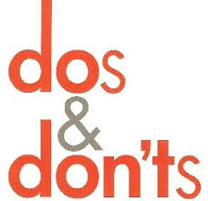
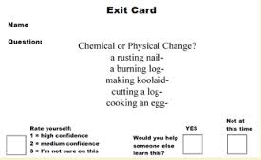
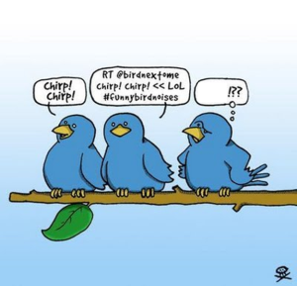
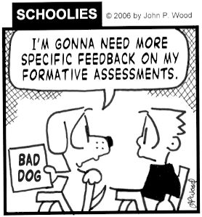
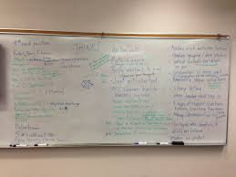
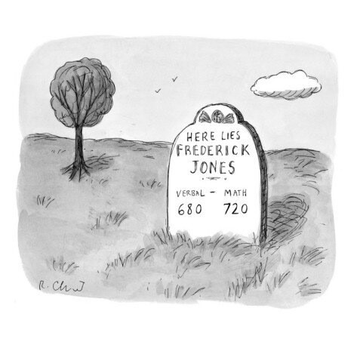
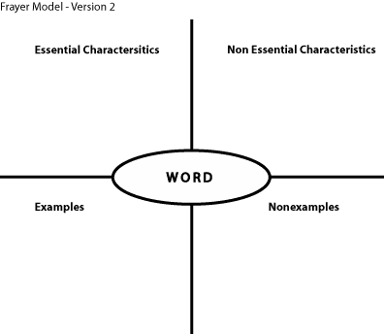
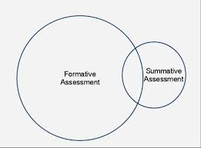
Notes:
The images will appear one by one as you click.
Briefly mention the name of each type of assessment as you show it.
Formative assessment examples – in order of appearance:
Thumbs up/down
exit cards
321
dos/don’ts
today’s meet
brain dump
graphic organizers like venn diagrams
frayer model
bury them epitaphs (summarizing)
Twitter/one sentence (also summarizing)

Slide 12
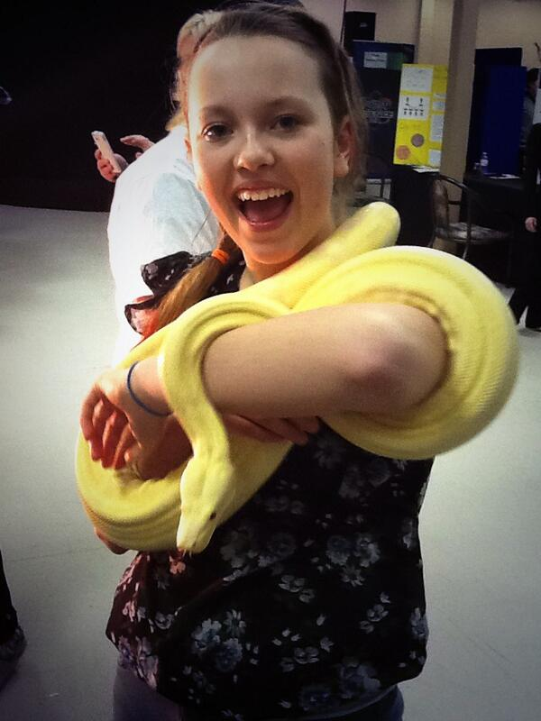
Three Common Misunderstandings
~ about DI
1. I have to change everything I do.
2. It takes too much time.
3. It’s just the latest bandwagon.
Image source: Shawn Allison
Notes:
Now we’ll use a quick formative assessment called “three common misunderstandings” – ours will be about DI – but for students it could be about a concept like fractions.
Random group at whiteboard.
Allow time to complete a list of three things.
Share via gallery walk.
Then show mine – they will appear one by one as you click.
*
I have to change everything I do.
*
2. It takes too much time.
*
3. It’s just the latest bandwagon.

Slide 13
Back to Front Activity
Anchor activities
Strategies you find less frequently in a DI classroom
Strategies you find frequently in a DI classroom
Formative assessment
Types of groupings
Notes:
Only the title will appear at first.
DESCRIBE HOW TO DO THIS SLIDE BEFORE YOU CLICK AGAIN!
Another type of formative assessment used to have students share what they know about a concept.
Arrange in partners with one partner (Partner A) having their back to the screen.
Partner B uses words to describe the category and Partner A has to guess the name of the category.
Partner B can start with any category.
Get groups all arranged before you click because all the categories will appear at once.
After activity:
In small groups, think of two or three ways you could use this activity in your subject/grade area. Why would you use it?

Slide 14
Retrieved from: http://youtu.be/qy_mIEnnlF4
Notes:
Video: Sheldon Trains Penny – 2:44
http://youtu.be/qy_mIEnnlF4
After:
Fortunately we do have other ways to teach students in the way they best learn!
The next activity is an example of a tiered activity.
Tiered assignments provide a better instructional match between students and their individual needs.

Slide 15
“Everyone Can Do It’ Tier
L - Raise your left hand
R - Raise your right hand
B - Raise both hands
Notes:
Have everyone stand.
Tell them that they will be seeing a series of letters – L, R, B – and that for each letter they will do the prescribed motion.
Have everyone practice by randomly calling out a few letters.

Slide 16
“Everyone Can Do It’ Tier
L
R
B
R
B
L
L
B
R
L
B
R
Notes:
Letters will appear one by one when you click.

Slide 17
“Just Right’ Tier
L - Raise your left hand
l - Sit and raise left hand
R - Raise your right hand
r - Sit and raise right hand
B - Raise both hands
b - Sit and raise both hands
Notes:
Okay, so now we’re adding a bit of a challenge.
A bit more complicated but you’ll get it.

Slide 18
“Just Right’ Tier
L
r
B
r
l
R
B
l
R
b
r
l
Notes:
Letters will appear one by one as you click.

Slide 19
“Tightened’ Tier
Same as before,
BUT,
if there is a comma, then the very next letter becomes the opposite.
(if it’s uppercase, it becomes lowercase)
Notes:
Now for a real challenge.

Slide 20
“Tightened’ Tier
L
r,
B
R
l,
R
B
l,
R
b
r,
l
Notes:
Letters will appear one by one as you click.
After activity:
Discuss insights about participating in a tiered activity.
What’s the benefits of having levelled activities?
What’s important in tiering?

Slide 21
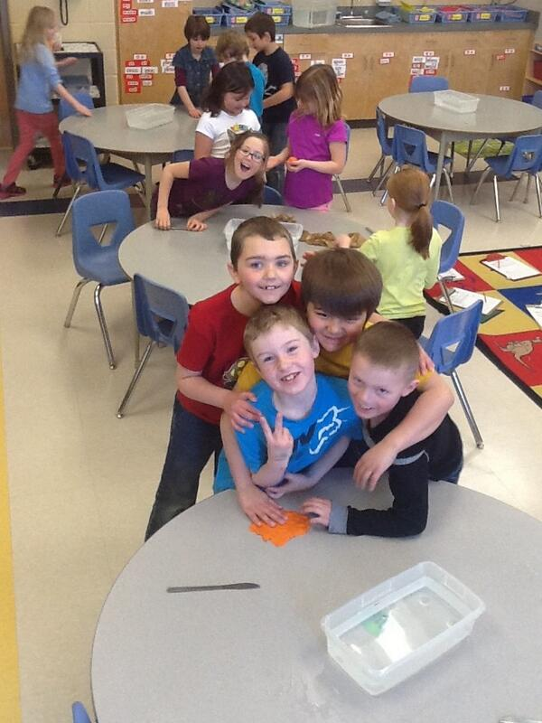
Raft Activity
Thinking about a differentiated classroom from other perspectives.
Role
Audience
Format
Topic
Image source: Danielle Dressaire
Notes:
DEPENDING UPON TIME – NEXT ACTIVITY REQUIRES AT LEAST 15 MINUTES - MAY NOT HAVE TIME FOR THIS ACTIVITY!
We’re going to try another tiered activity – involving writing.
This time we will work in individually or in partners… your choice.
Have partners select one of the rows that is of interest to them and do what that row asks them to do.
Share writing in small groups.
Ask whole group if there are any they wish to share – their own work or another group that they heard.
Whole group: discuss how this is tiering.

Slide 22
Retrieved from: http://youtu.be/0akVmCfUJiQ
Notes:
Video: Lesson Observation – 7:40
http://youtu.be/0akVmCfUJiQ
While watching video look for:
DI strategies
Things you wonder about
After video:
Table groups at whiteboard – discuss and make list.
Gallery walk.
Possibly whole group share after.

Slide 23
Retrieved from: http://youtu.be/Xbk2QAsHHu8
Notes:
Video: The Top Ten Things You Don’t Learn About Teaching in College – 2:32
http://youtu.be/Xbk2QAsHHu8
Discuss lunch plans and afternoon plans.

Slide 24
References
Tomlinson, C & Eidson, C. (2003). Differentiation in Practice. Alexandria, VA: ASCD.
Tovani, Cris. (2011). So What Do They Really Know?. Markham, ON: Pembroke Publishers.
Wiliam, Dylan. (2011). Embedded Formative Assessment. Bloomington, IN: Solution Tree Press
Wormeli, Rick. ( 2007). Differentiation. Portland, ME: Stenhouse Publishers.
Wormeli, Rick. ( 2006). Fair Isn’t Always Equal. Portland, ME: Stenhouse Publishers.

